Slide 1

Induction Training 2023
Michael O’Brien
EDI@ul.ie)
Human Rights – EDI Project Officer

Slide 2
EQUALITY DIVERSITY AND INCLUSION
The Human Rights & EDI Office is committed to building and maintaining an inclusive environment which promotes equality, values diversity and respects the rights and dignity of our staff and students.
Our EHR mission is to ensure that all staff and students are provided with the opportunity to achieve their maximum potential within the University of Limerick.
Our vision is to be a university that embraces EHR though its people, structures, actions, values and culture.
Notes:
EQUALITY (of opportunity) can be defined as the basic right to not be disadvantaged or discriminated against because of a characteristic such as one’s sex or ethnic background.
Equality, however, is not just about removing discrimination or disadvantage. It is also about creating a society that is fair and transparent, where everyone, regardless of individual differences, is able to participate in work and life and fulfil their potential.

Slide 3





The drivers in the Sector
2015 - 2021
2019
2022
2014
Notes:
AS charter launched in Ireland in 2015 with funding support from the Higher Education Authority – focus on advancing the careers of women in STEM. UL First institution with TCD to achieve a bronze.

Slide 4
A statutory requirement on public bodies to take proactive steps to:
  Promote equality of opportunity prohibit discrimination and protect human rights
    For service users, policy beneficiaries and employees across all function areas.
    UL HREDI Strategy
    A common set of values that underpin both Equality & Human rights.
Notes:
S42 of the Irish Human Rights and Equality Commission Act 2014: the public sector equality and human rights duty (the Duty. At a sectoral level we have come together to develop a framework to assess where we are at as an institution. Look at what we are doing and takes a broad look at the Human Rights Issues within our institution. It sets out the need that the duty – and HREDI issues become an integral part of all our work. Part and parcel of how we do our business.
It requires a driver embedded approach to our business and in so doing drive a cultural change. A values led approach focuses on culture change. Values at the heart of the culture of the institution and at the heart of embedding the focus of the duty. Important to look at equality & Human Rights together.
A common set of values that underpin both Equality & Human rights. With the IUA group we identified a set of core values.

Slide 5
Our Responsibility as Irish Higher Education Institutions
To promote gender balance and equality of opportunity among students and employees of the university” (Universities Act 1997)
To eliminate discrimination and promote equality of opportunity and treatment of its staff and persons to whom it provides services” (Irish Human Rights and Equality Commission Act 2014).
Notes:
Just to say at the outset that Whilst the higher education sector has made significant progress in gender equality, through self-assessment and the development and implementation of action plans, and new leadership structures, there is much still to do to achieve and embed sustained cultural change.

Slide 6
The Irish Higher Education Sector
Across our sector, addressing gender equality has been at the forefront of our EDI agenda in recent years. Major focal points have included the introduction of the Athena SWAN Charter (a gender equality self-assessment accreditation scheme -since 2015), and the HEA Review of Gender Equality (2016), resulting in a concerted collective effort across the entire sector to accelerate the necessary change.
Considering Intersectionality a framework for thinking about how various forms of inequalities are interconnected for minority women and other under-represented groups includes issues of sexism, racism, homophobia, transphobia, ableism (thinking of the world solely from the perspective of able-bodied experiences) and class discrimination, amongst others is a key priority for the sector.

Slide 7
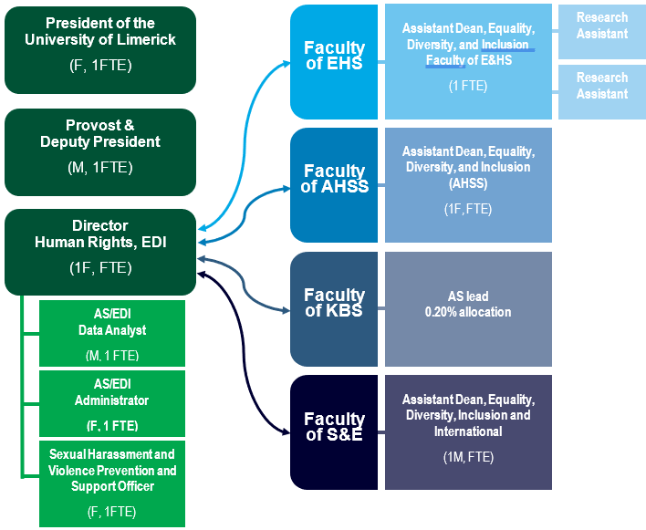
HREDI STRUCTURE

Slide 8
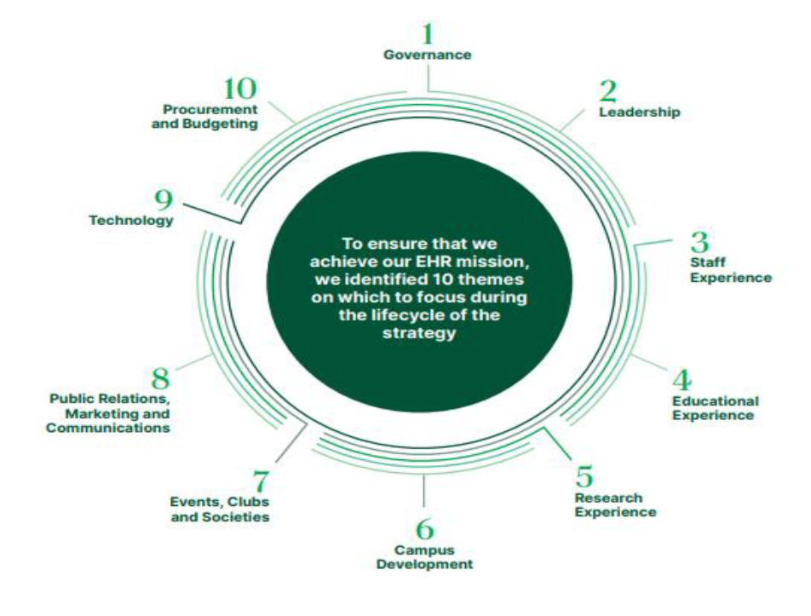
https://www.ul.ie/UL_Equality_and_Human_Rights_Strategy.pdf
Notes:
The strategy outlines plans for the mainstreaming HREDI up to 2022).
10 KEY Themes Governance; Leadership; Staff Experience;
Educational Experience; Research Experience; Campus Development; Events, Clubs and Societies; Public Relations, Marketing and Communications; Technology; Procurement/Budgeting. Action Register. The strategy is up for review this year and a new Human Rights EDI Committee will develop and agree a plan for 2023 to 2206.

Slide 9
Notes:
HR-EDI Organisational chart EDI showing the 4 pillars which underpin the HR-EDI Committee chaired by the Provost and which feeds Executive Committee
Pillar 1 Gender Equality (AS-EDI)
chaired by the President and is the Institute SAT (Self Assessment Team) for Athena Swan. Faculty and Assistant Deans EDI
Working groups PMSS, Academic, Research, Inclusivity Working groups
Pillar 2 Universal Design for Learning
(Accessibility Accessible Campus) Staff Disability working group, Autism in UL Special
Pillar 3 Diversity & Inclusion
Ethnic Diversity Forum, University Sanctuary Committee, Age Friendly University
Pillar 4 Sexual Health and Wellbeing
Consent Framework , Sexual Health and Wellbeing

Slide 10
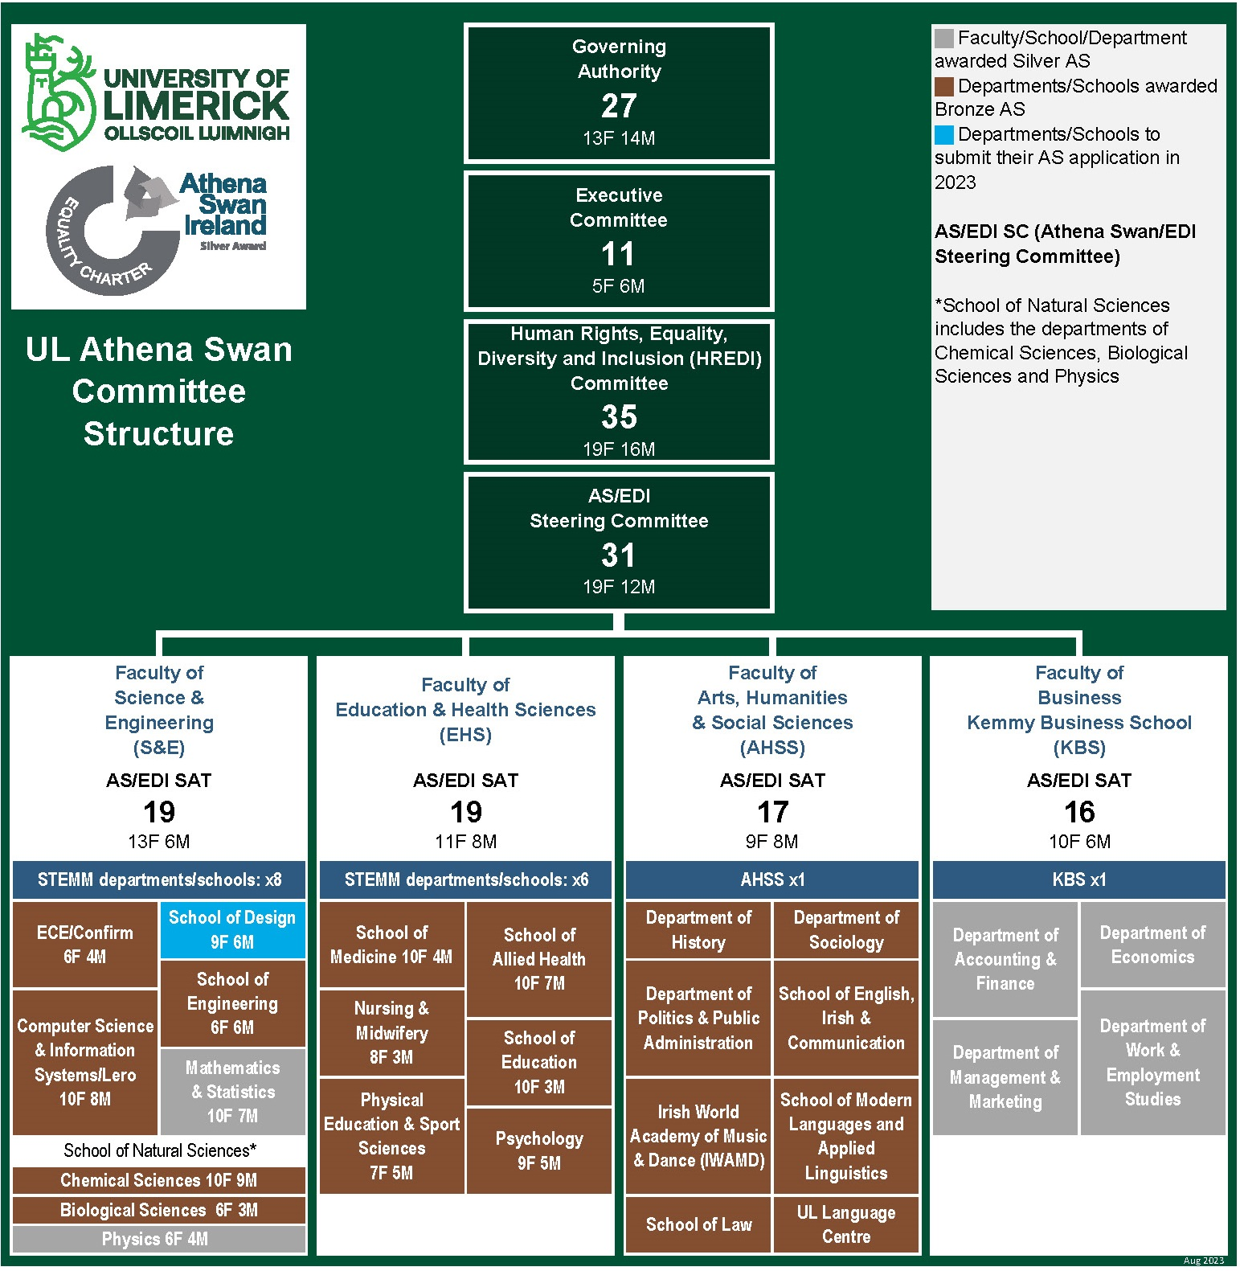



NETWORKS
Notes:
Gender Equality has been embedded across the institution. You have joined an institution of First.
First institution with Trinity College to achieve an Athena SWAN award which at that time was focussing on the careers of women in STEM.
First institution to renew to the Expanded Charter which seeks to achieve equality across all disciplines, and support for Trans Staff & Students.
First institution to achieve a Silver Department Award in the ROI – by our Physics Department
KBS joined Physics with a Silver award this year.
Maths & Stats awarded their silver last week.
1st Irish Institution to hold a Silver Institution Award. Trinity awarded Silver this August.
This brought to 16 dept awards we currently have 27 to our 30 department academic depts, with the remaining submitting
This was not an easy task and took total commitment by Deans & HoD’s in taking the framework on board.
Now being extended to included the broader EDI Agenda and Professional & managerial staff etc. and all of these Teams at Institutional, Faculty & Department level we will now utilise to support the broader EDI Agenda Human
APEX (Academic & Professional Empowerment Network; (Open to all staff as a networking opportunity & promote EDI)
Athena SWAN internal Network: (Share knowledge and experience locally and links in with National AS Network.
WiSE (Women in Science and Engineering)
eMerge (Peer support network for Early and mid-career academic staff)
Evolve Network peer to peer network & informal space for PMSS staff to share knowledge
available to you as staff

Slide 11
Athena Swan Silver Action Plan (SAP) 2022 - 2026
Key | Institution Priority | Description
GE 1 | Inclusive Leadership | Strengthen trust, improve communication and build capacity to ensure that the institution’s leadership and committee structures are representative and inclusive.
GE 2 | Gender Equality at Senior levels | Increase the number of women at full professorial level to 40% by 2026.
GE 3 | Data Gathering - Gender Equality & intersectionality | Roll out an extensive self-declaration campaign encouraging staff to declare their race/ethnicity and disability through the Core Personnel System.
GE 4 | Workload | Implement a fair and transparent academic workload model.
GE 5 | Career Pathways | Implement career pathways for all staff.
AEG 1 | Safe & Respectful - Dignity and Respect (Bullying & Harassment) | Roll out an anti-bullying and harassment campaign in line with the publication/updating of relevant polices.
AEG 2 | Intersectionality, Inclusion/Ethnicity and Belonging | Undertake a campaign to address intersectional inequality and provide further educational programmes for staff and students.
AEG 3 | Different Abilities | Develop best practice recruitment processes for employing people with disabilities.
AEG 4 | Age | Become an Age Friendly University/University of the Third Age.
AEG 5 | Enhancing culture and life at work , Inclusion & Belonging | Measure the effectiveness of AS actions to enhance the culture of UL as inclusive and supportive through ongoing staff surveys and focus groups.
Notes:
The new charter requires us to set out 5 key priorities under Gender Equality and 5 key priorities under Additional Equality Grounds.

Slide 12

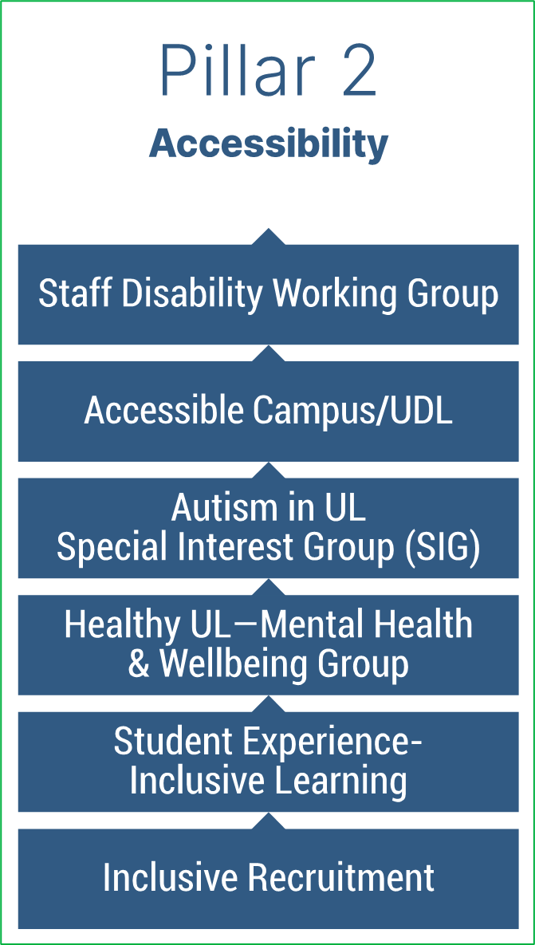
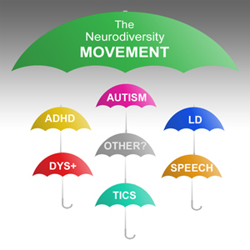

Notes:
Pillar 2 is the area of Disability, Universal Design, Assistive Technology, Inclusive Learning, Inclusive Recruitment etc.
Huge work taking place across the campus thought our Assistive Technology Unit, Teaching & Learning, The Autism Interest Group and looking at the broader area of other Neurodiversity challenges –
INCLUSIVE RECRUITMENT the recruitment of people who identify as being neuro diverse and to see how we can have a broader reach and support individuals to apply for posts in UL.
We are also about to set up a Staff Disability Network to support staff who have a disability, have a long-term health condition or neurodivergence and to support those working with or who are interested in inclusive practices

Slide 13





Notes:
10Key Principles – to engage the silver economy and make UL more inclusive.
Age friendly University
To encourage the participation of older adults in all the core activities of the university, including educational and research programmes. We have set up a working group
Ethnic Diversity Forum to understand and advocate for a positive campus climate in relation to ethnic, equality, diversity and inclusion and to make recommendations and progress actions that aim to make UL an equitable, safe and respectful work and study environment for all.
All welcome particularly Staff and Students with LIVED EXPERIENCE OF COMING FROM DIFFERENT ETHNIC BACKGROUNDS.

Slide 14




Notes:
ACTIVE CONSENT
the union of students in Ireland survey between 2019 and 2020 showed
level students at the beginning stages of dealing with alcohol, drugs and sexual intimacy have a lack of understanding around consent.
Engaging these students at an early stage in Consent Training by increasing their knowledge and enhancing their understanding of consent and how to embark on positive sexual relationships. 43% of respondents had unwanted sexual experience.(51.5% F)
The Active Consent Framework was rolled out by the Minister for Higher Education Simon Harris Roll in 2020 setting out a number of key actions that institutions must implement including the roll out of active consent workshops to all 1st year students Mandatory. New policies are being developed for staff & student on Sexual Harassment, Sexual Misconduct and Sexual Violence.
Alongside this a new Speak out tool for anonymous reporting of incidents.
Sexual Harassment & Sexual Violence Prevention and Support Officer based in EDI office.
to offer confidential support and provide services to those who have experienced or are experiencing incidents of sexual assault and sexual harassment.
facilitate education and training workshops on Active*Consent that drives a culture of consent
Student Designated Contacts Panel also being put in place.

Slide 15
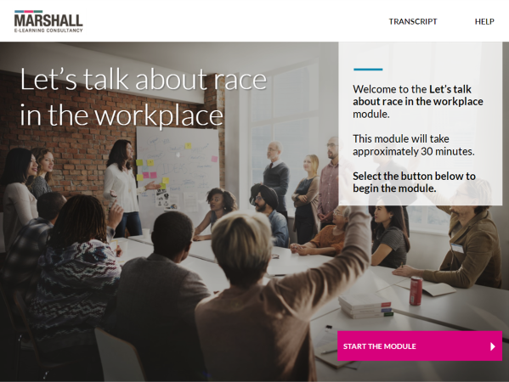

Standing Together: Embracing Diversity at UL - YouTube
Notes:
There are a number of training opportunities available to you
EDIinHE online Training; (Staff)
Let’s Talk About Race (on-line Training) – For Staff & Students
Unconscious Bias Training (on-line Training) – Staff
Bystander Training (on-line) – Staff & Students
Intercultural Awareness Training (Staff )
On-going roll out of Intercultural Events
Formal Mentoring Programme
Universal Design/Inclusive Learning
Access & Outreach Programmes
Graduate Certificate in Equality Diversity and Inclusion (FAHSS)

Slide 16





Connecting with the Campus Community
#TogetherWeAreIDAHOTB
Notes:
EDI promote and organise series of events to help highlight & celebrate the diversity of the University Community.
Eid, Diwali

Slide 17


ENGAGING THE CAMPUS COMMUNITY

Slide 18
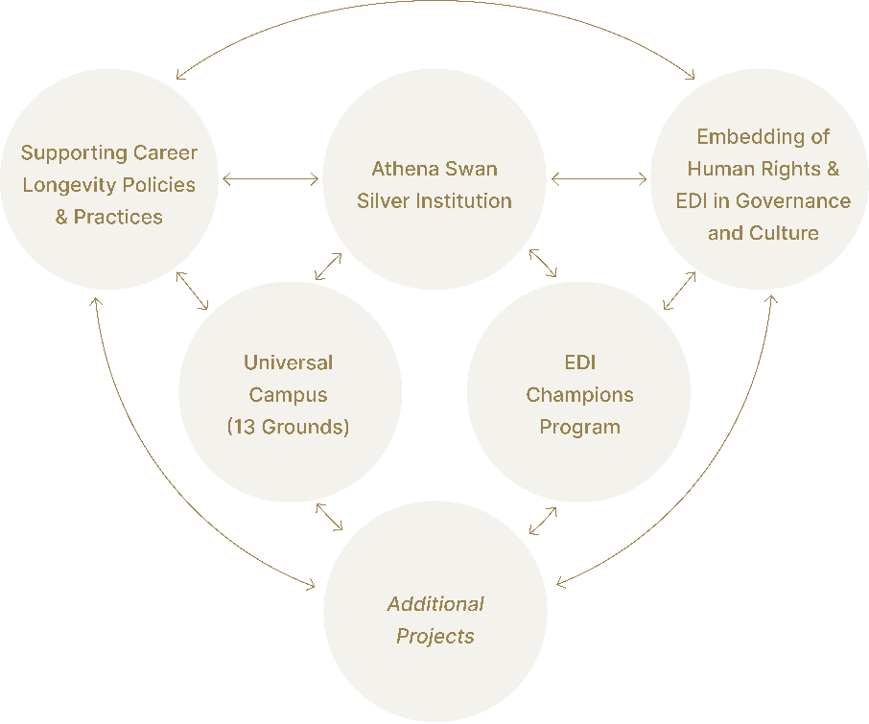
UL Egalitarian University Mission Projects
Notes:
As part of the recently launched Sustainability framework 2030 to rebalance social progress within environmental constraints UL has set a series of grand challenges based on the UN Sustainable development goals and one of those is to become a truly egalitarian university
Based on
embedding HR-EDI into all aspects of UL’s operations and culture.
implementing the Silver Institution Action Plan and supporting depts to achieve bronze & silver awards
Age friendly University

Slide 19
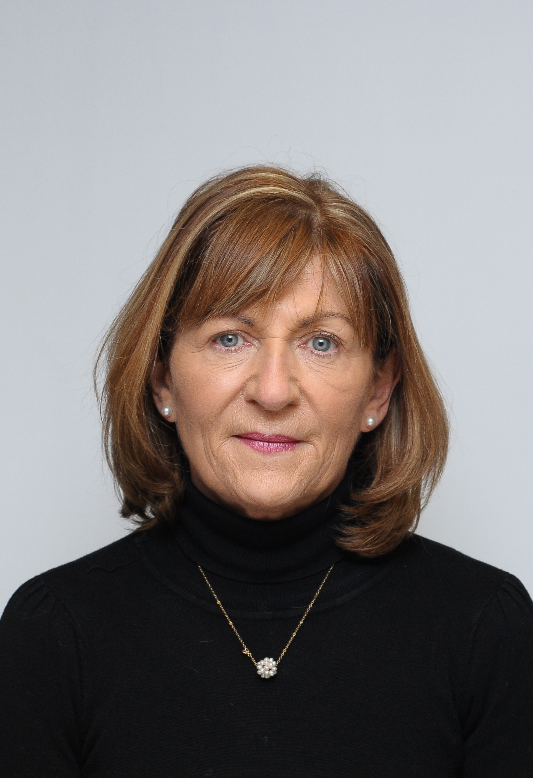
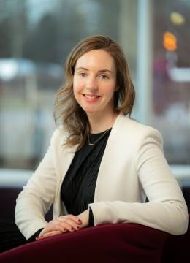
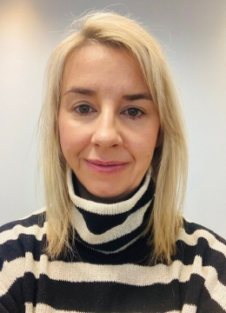
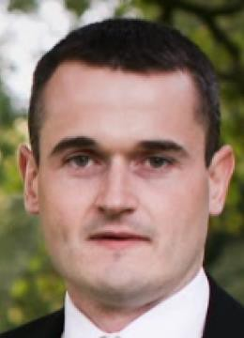
Meet the EDI Team – EMAIL EDI@UL.IE
Dr. Marie Connolly
Maureen Keogh
Michael O’Brien
Data Analyst - Athena SWAN/EDI Projects Officer
Director Human Rights, Equality, Diversity and Inclusion
Human Rights, Equality, Diversity and Inclusion Administrator
Maria Healy
Consent Framework Co- Ordinator
Notes:
Our team is Lead by Dr Marie Connolly Director of the Office of Human Rights, Equality Diversity and Inclusion.

Slide 20

This Photo by Unknown Author is licensed under CC BY-SA

