Slide 1




Induction Presentation 2023
Human Resources Division
Dave Hennessy and Alison O'Regan
HR Division

Slide 2

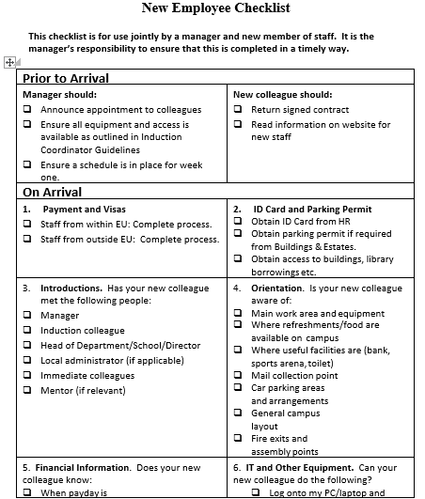
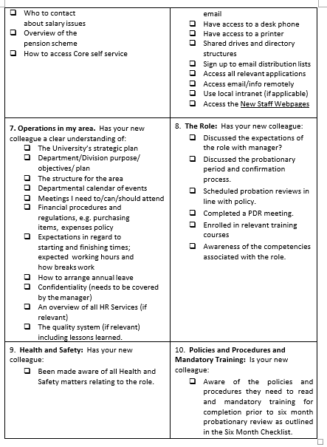


What You Need to Know – Employee Checklist
https://www.ul.ie/media/26320/download?inline

Slide 3
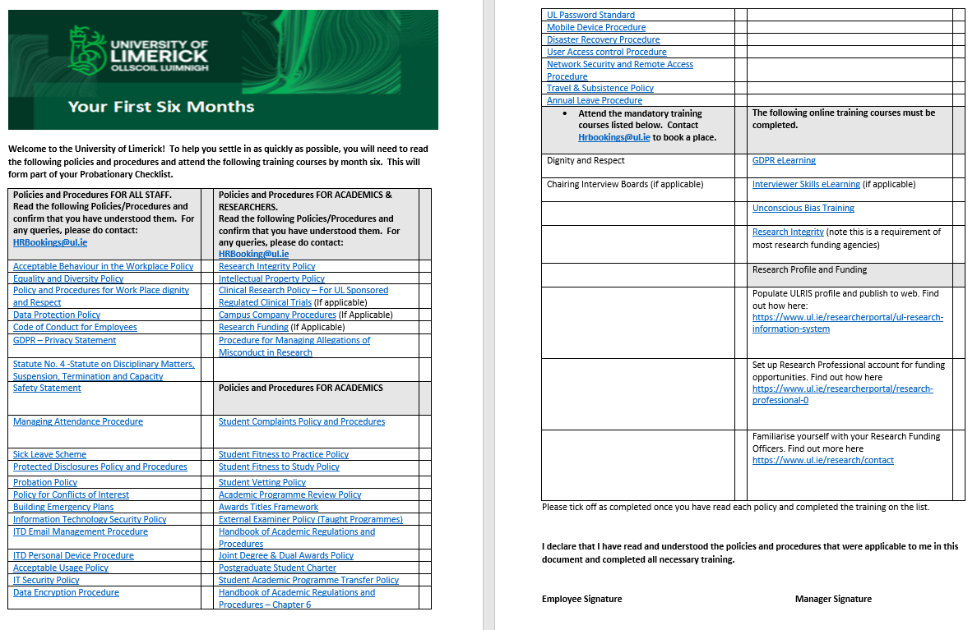
What You Need to Know – The First Six Months
https://www.ul.ie/media/27183/download

Slide 4

What You Need to Know – The First Six Months
Responsibility to familiarise yourself with Policies and Procedures
“I have read and understood….”
Dignity and Respect; Grievance; Conflict of Interest; Code of Conduct; etc.
Part of Six Month Probation
POLICIES AND PROCEDURES

Slide 5
What You Need to Know – The First Six Months
Dignity and Respect
Performance and Development Reviews
Interviewer Skills Training
Unconscious Bias
Data Protection (GDPR)
IT Security
Research Integrity
TRAINING AS YOU GET STARTED

Slide 6

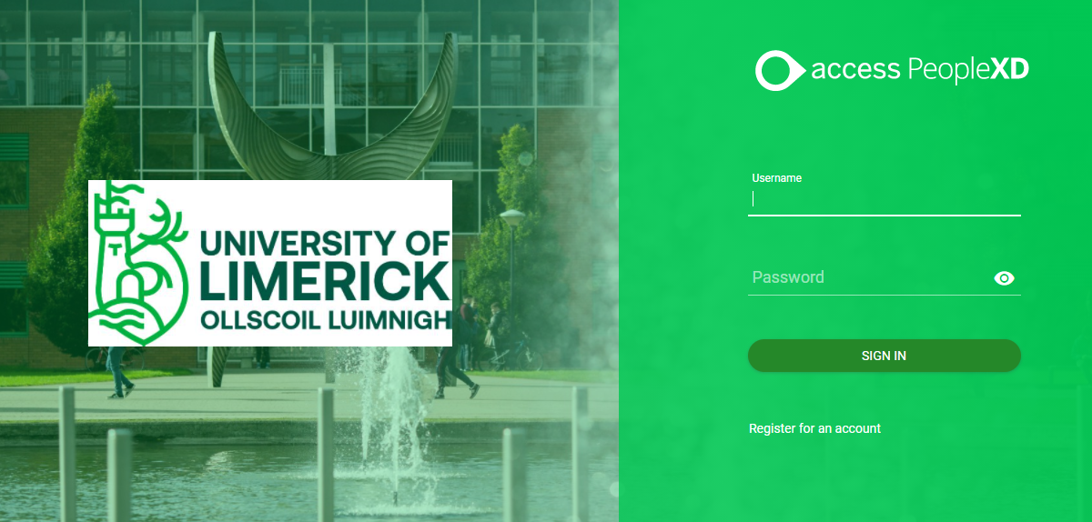
What You Need to Know – Core Portal
Pay Related Information
Annual Leave
From the HR Pages, click on Core Portal
Click for Further information and How to videos
For Off Campus access to Core Portal please see further
information on TopDesk
Core Portal

Slide 7
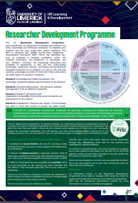
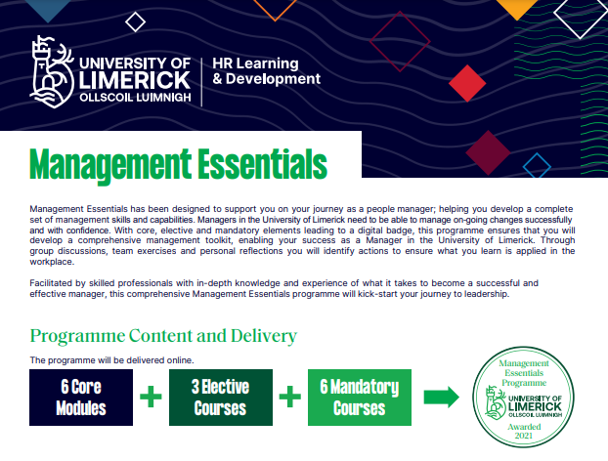
What You Might Like to Know - Career Support
Training and Development Opportunities:
          Research Development Programme
          Personal Development
          Management Essentials
          Academic Staff: Early Career,
          Course Director, PhD Supervision, etc.
The Role of your Manager:
        Performance and Development Review
Equality, Diversity and Inclusion – Athena Swan
Progressing your Career:
          Roles publicly advertised
          Progression / Promotion
      Other Supports:
              Competency Frameworks
        Mentoring / Research Coaching
        Erasmus
        (www.ul.ie/hr) & join our Talent Development (HR) space on UL Connect

Slide 8




What You Might Like to Know – Networks & CoP
EVOLVE Community of practice is a group of like-minded people who want to offer a safe space for professional support staff to share knowledge, support one another and connect.
EMerge is a peer-support network for Early and Mid-career academic staff.
APEX is the Academic & Professional Empowerment Network set up in 2021. Its purpose is to enable wider engagement and relationship-building with all UL staff, while championing a professional culture of equality, diversity & inclusion.
Universal Design for Learning and Inclusive Practices at UL Community of Practice.

Slide 9
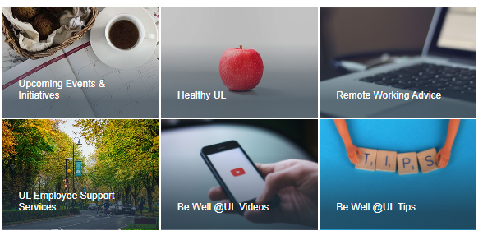
What You Might Like to Know – BeWell@UL Wellness

Slide 10



University of Limerick, Limerick, V94 T9PX,
Ireland.
Ollscoil Luimnigh, Luimneach,
V94 T9PX, Éire.
+353 (0) 61 202020
ul.ie
Thank you

