Slide 1
Inflation- lessons from the 1970s
Ciarán Casey

Slide 3
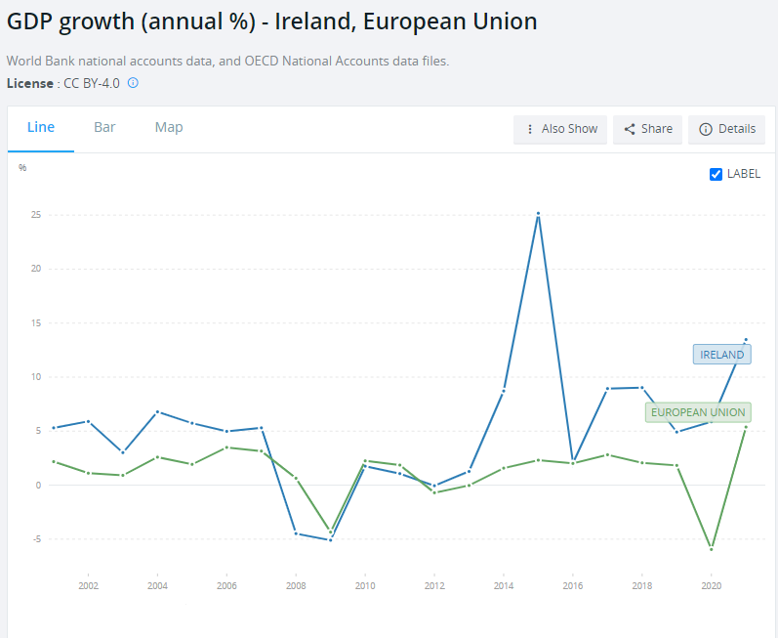

Slide 4
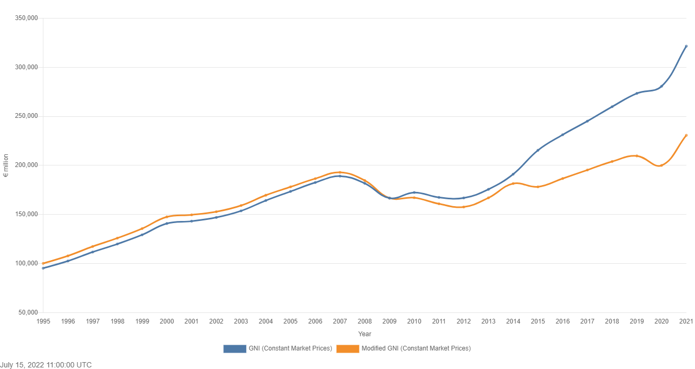

Slide 5
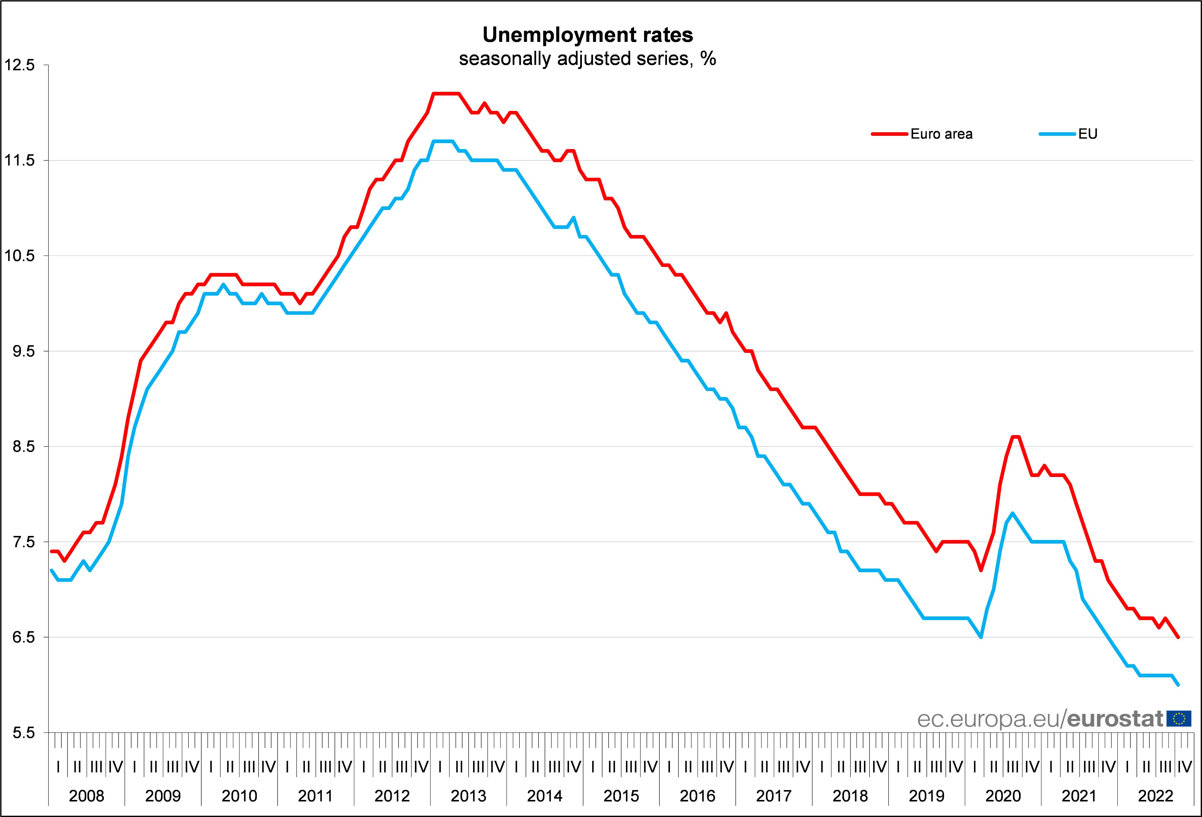

Slide 6
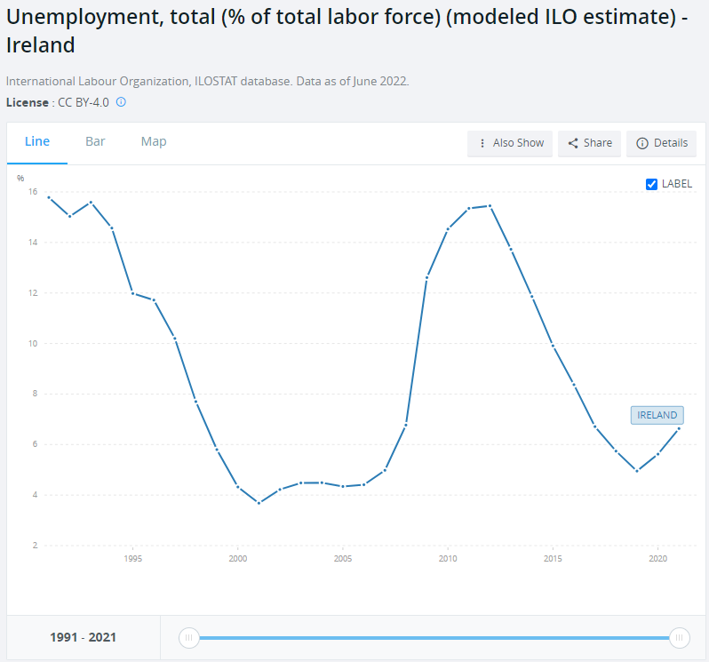

Slide 7
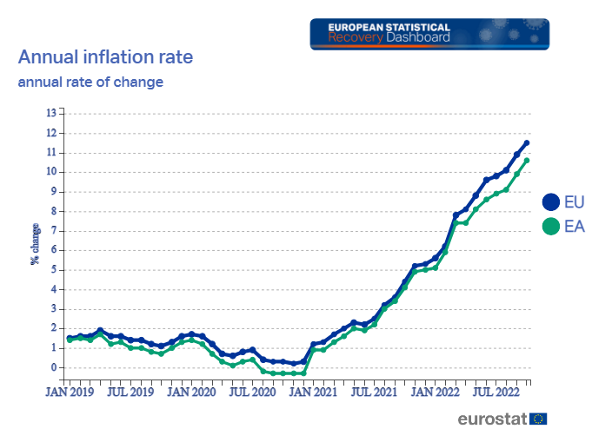

Slide 11
Causes
Clogged up supply chains after lockdown (and pent-up demand!)
The war in Ukraine and associated sanctions
Persistent lockdowns in China- cities with 74 million people in June! Congestion in Chinese ports

Slide 13
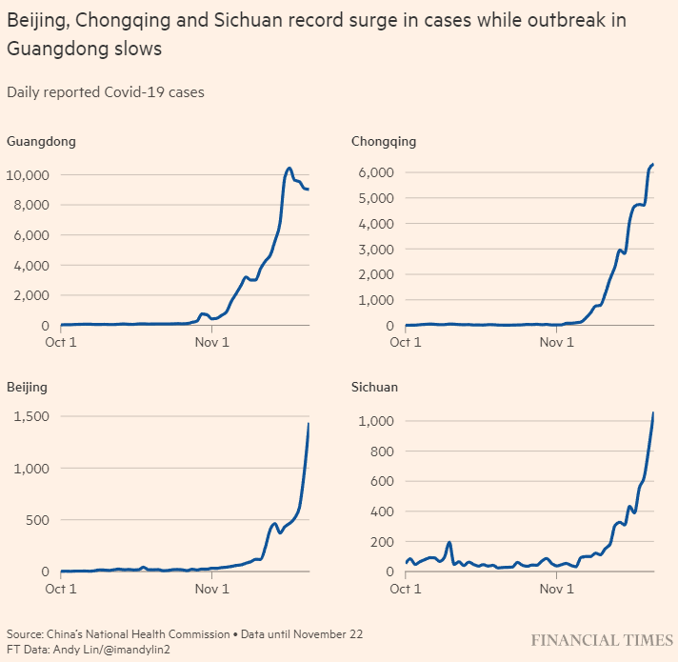

Slide 14
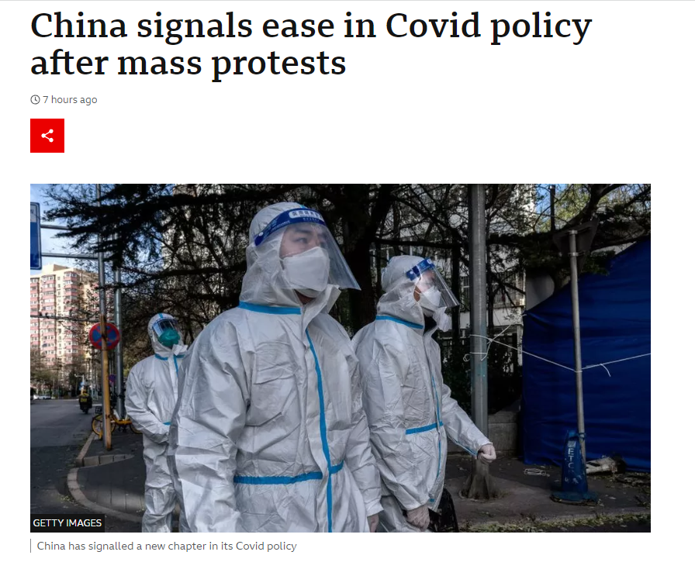

Slide 15
What Causes Inflation? The Monetarist View
Milton Friedman- “too much money chasing too few goods”.
MV = PQ
M is the money supply,
V is the velocity
P is the price of goods and services
Q is the quantity of goods and services.

Slide 16
Does inflation harm growth?
Paper | Finding
Friedman (1968) | No permanent trade-off between inflation and unemployment
Friedman (1976) | Reduces information from relative prices and thus economic efficiency
Bruno and Easterly (1998) | No robust evidence annual inflation below 40% lowers growth
Faria and Carneiro (2001) | Negative effect on growth in the short run, no impact in the long run
Burdekin et al. (2004) | Hurts growth within single digits
Gillman and Keyjak (2011) | Harms investment and output growth
Thanh (2015) | Negative impact over 7.84%
Bachmann et al. (2015) | Very small impact on consumer readiness to spend
Akinsola and Odhiambo (2017) | Negative but threshold varies
Law and Soon (2020) | Worsens inequality

Slide 17
Korean inflation

Slide 18
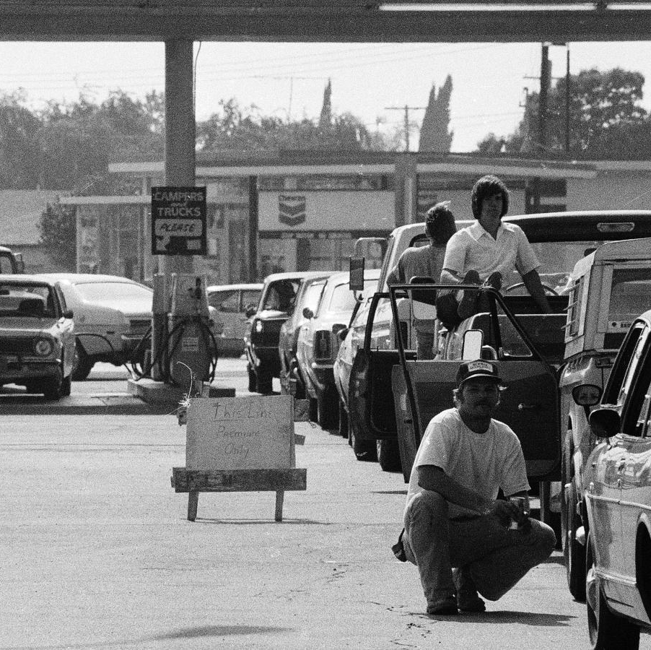
Why this is and isn’t like the 1970s
1973 and 1979 oil crises- pervasiveness of oil and reliance
But, Q2 2022: Year-on-year wages up 4% in the euro area and 4.4% in the EU (Eurostat).
Inflationary expectations aren’t embedded in the medium-term in the same way (Paul Volcker)

Slide 20
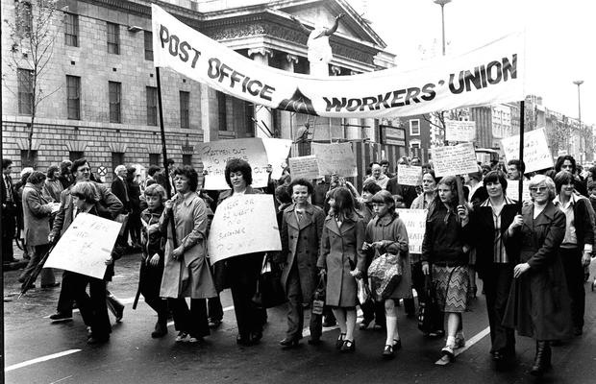
1.4 million strike days lost in 1979!

Slide 21
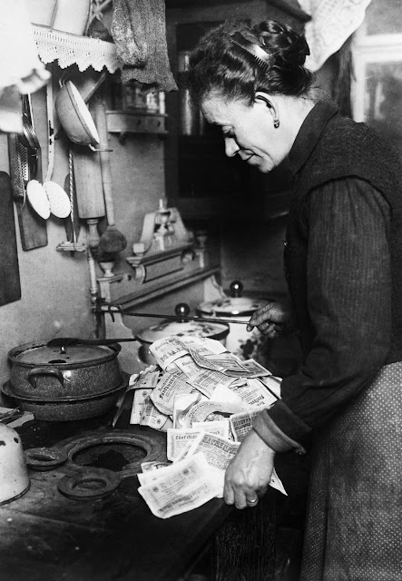
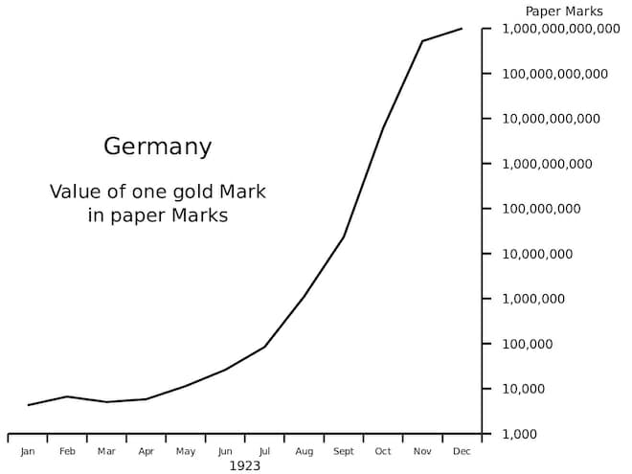
Why this isn’t like the 1920s
Many advanced countries have graduated from bouts of runaway inflation (Reinhart and Rogoff).
But looms large in the minds of policymakers.

Slide 22
Winners and Losers
Winners:
People holding debt at fixed interest rates
Energy exporters
Losers:
People holding cash
Workers and businesses whose income doesn’t keep pace
Energy importers (Shift in Terms of Trade: oil imports jumped from 2.6% of Irish GNP in 1973 to 7.6% a year later!)

Slide 23
The National Policy Response
Fiscal policy- lesson of the 1970s is can’t insulate all of society from the impact indefinitely. ECB expects this to be relatively quick so don’t try!
Insulate low-income households
Richie Ryan: ‘common sense, a little patience, more give and less take. In other words, a readiness to forgo a little today so that we and our children can have a better tomorrow.’

Slide 24
The European Policy Response
ECB mandate to maintain price stability (2%)
(The Treaty on the Functioning of the European Union, Article 127)
July 2022- first increase since 2011
Has committed to get inflation back this 2% the medium term, predicting 2.1% in 2024.
Likely employment impact
Impact on public debt, especially in Italy, Portugal and Spain.

Slide 25
Possible outcomes
Huge variation in impacts by country depending on its fuel mix- Austria
If gas supplies are cut in the winter the European Commission expects GDP to fall by 1.5%. But this underestimates the human and societal impacts.
Ireland- Reports of falls in construction and consumption.
No devaluation option within the eurozone. Lesson for Ireland from 20 years ago is don’t become uncompetitive vis-à-vis eurozone partners.

Slide 26
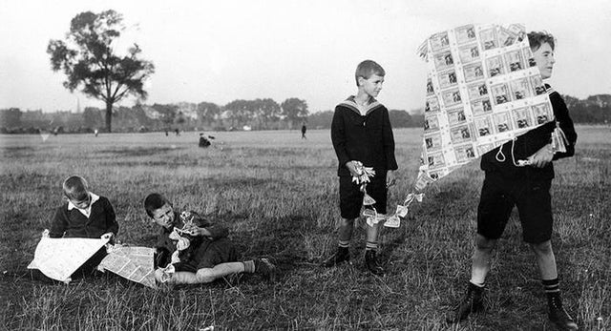
Thank You!

