Slide 1




www.ul.ie/research

Slide 2




Office of the Vice President Research
Strategy and Policy
Research Governance – University Research Committee, UL Ethics Group, Research Integrity
Partnerships, Business Engagement, and Technology Transfer
Funding Support (Funder Engagement & Positioning, Proposal Development & Authorisation)
Post-Award Support & Compliance (health research, institutes & centres)
Metrics, Reporting, Rankings
Research Impact: President’s Research Excellence and Impact Awards
Institutes & Centres (externally funded and internal centres)
Doctoral College
Research funding contracts
Notes:
Awards and Accolades
QS World Rankings Top 500 and 5 Star Status.
Times Higher Education Impact Rankings Top 100
GreenMetric 23rd in the world.
QS Graduate Employability Rankings Top 200
Top 75 Universities in Europe for Excellence in Teaching and Learning
The Education Awards – 1st for Excellence, 1st Best Student Campus, 1st Student Engagement & Communications

Slide 3


Research Strategy 2022-2027
Wisdom for Action
Eagna chun Gnímh

Slide 4

Mission
Our mission is to build a vibrant community where research excellence is valued, supported and central to all facets of our organisation

Slide 5
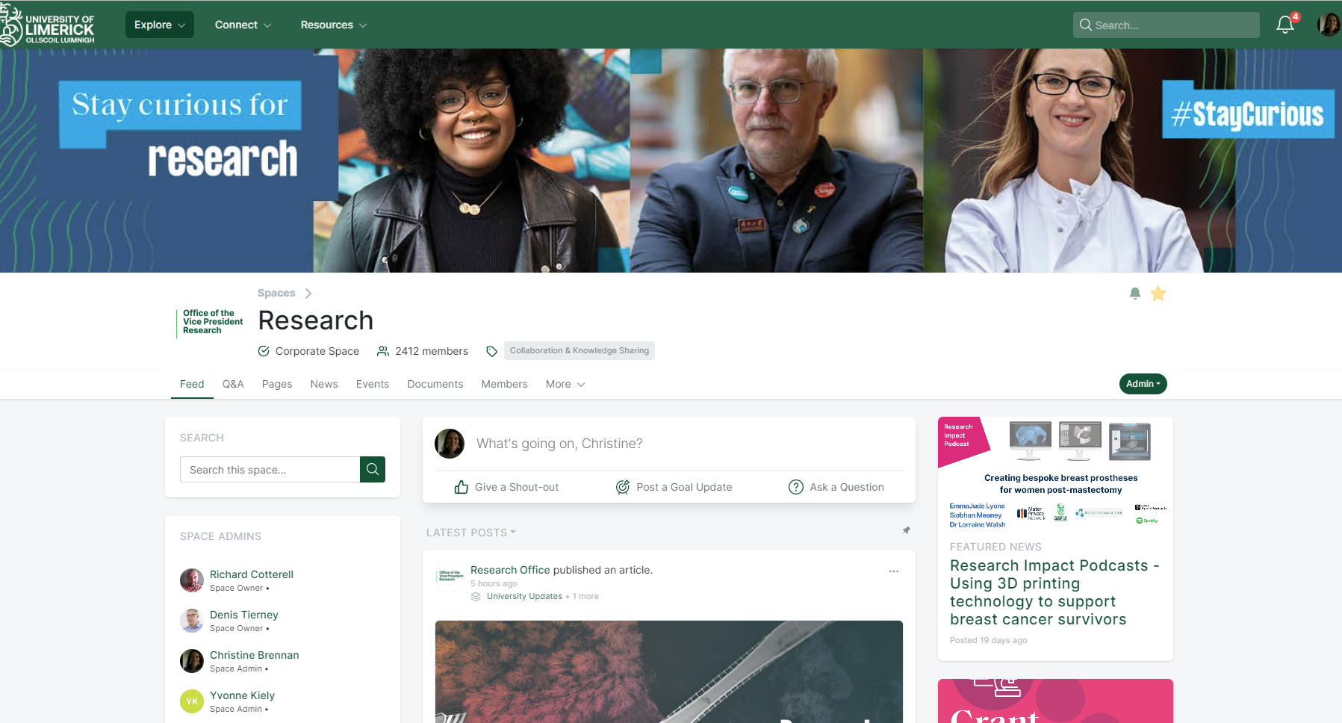
Research Supports
Research Finance Office
HR
Graduate and Professional Studies
Marketing and Communications
Library
Bernal Institute & Health Research Institute
Faculties & Departments
Centres

Slide 6
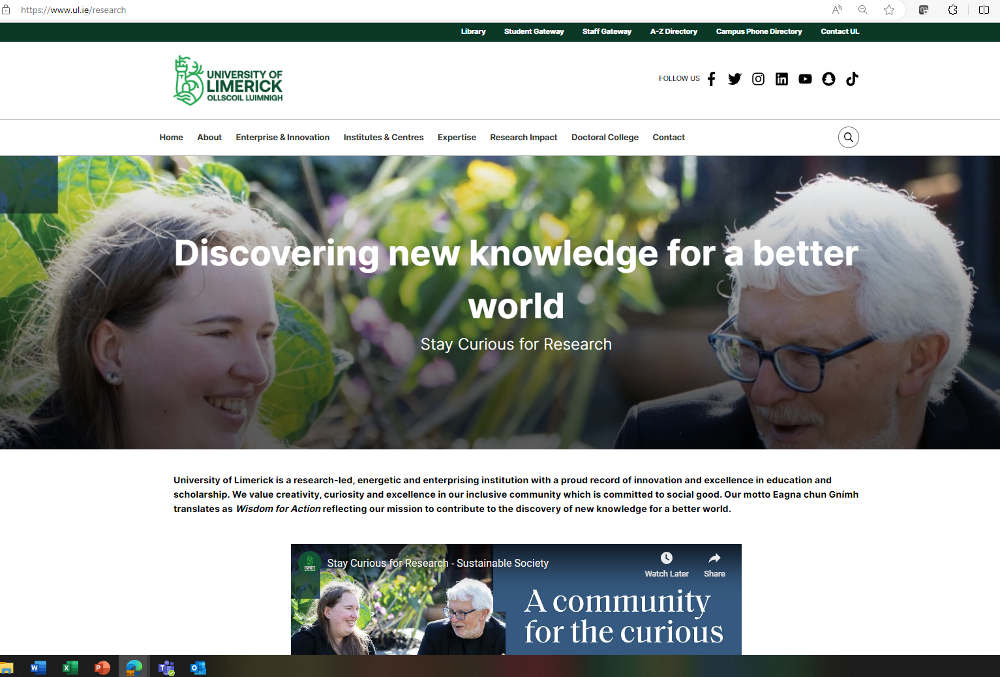

Slide 7
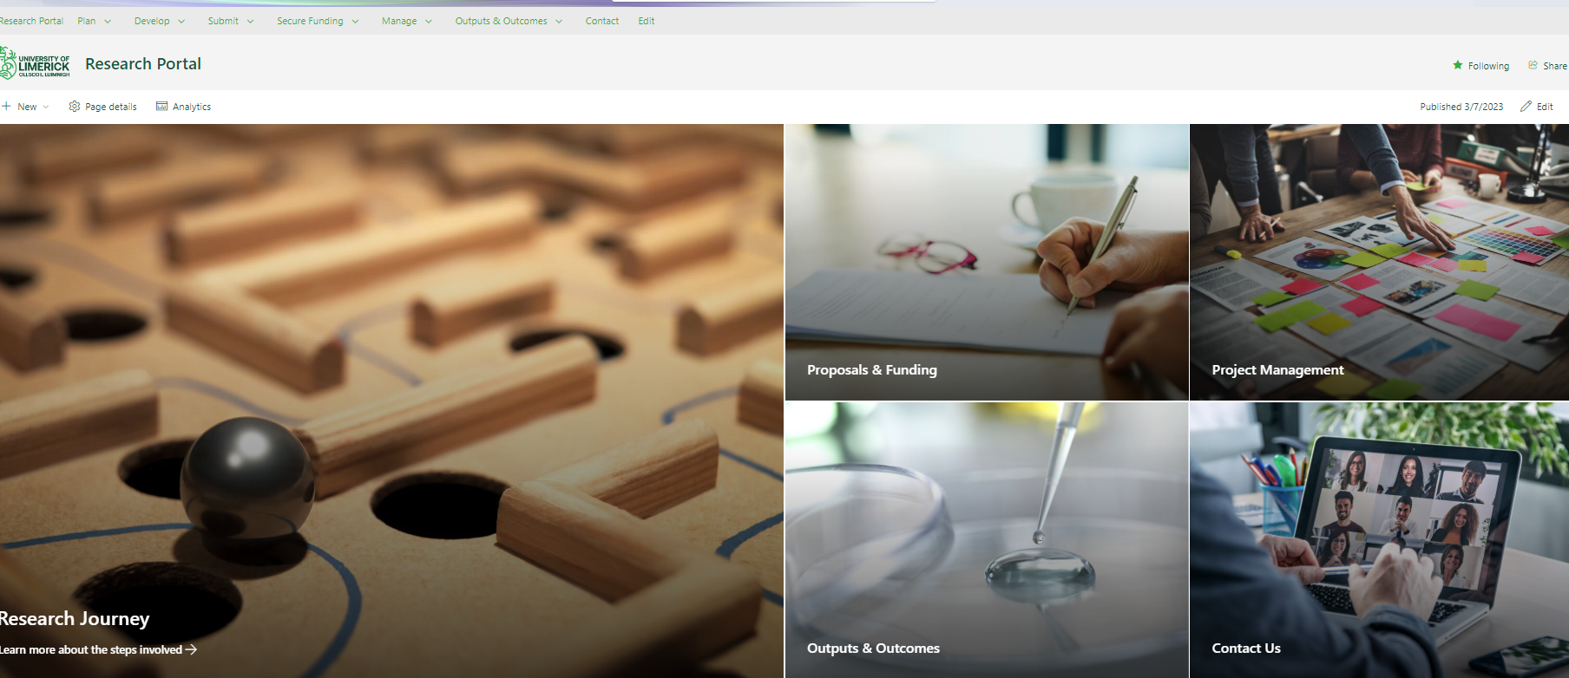

Slide 8
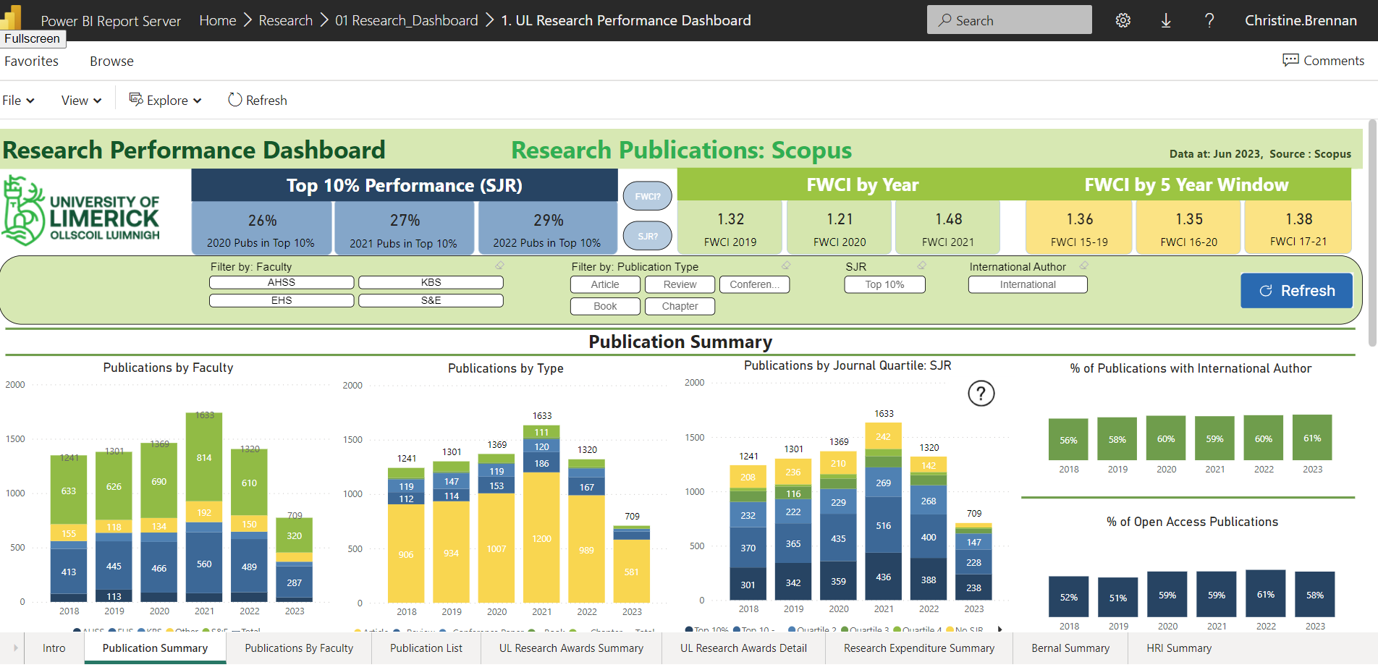
For queries relating to the Research Performance Dashboard, please contact eileen.f.oconnor@ul.ie.

Slide 9


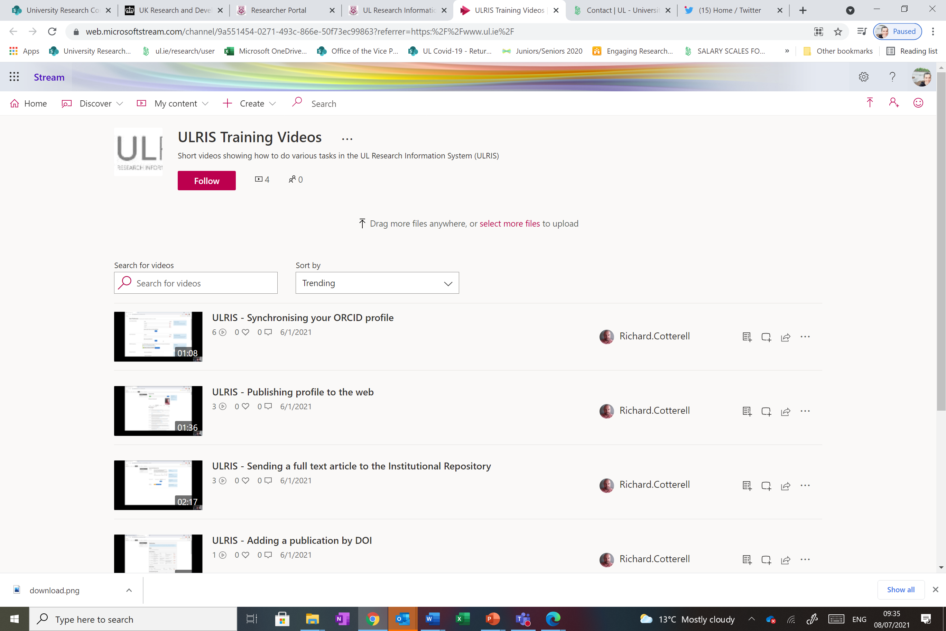
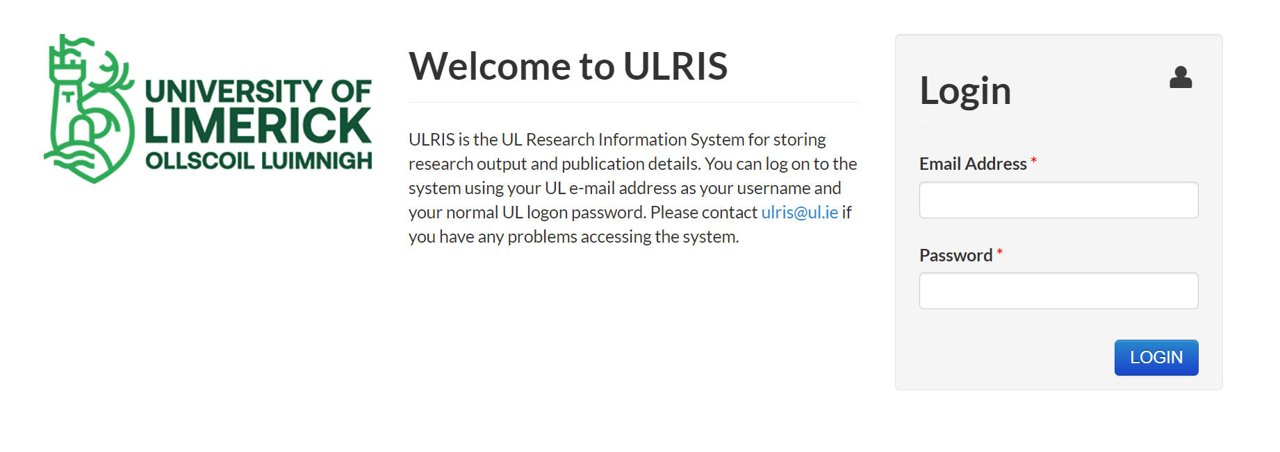
UL Research Information System (ULRIS)
Web-based system for research profiles
Single point of entry for research information
Generate profiles for webpages
Upload full-text publications to UL Institutional Repository
Automatically imports Scopus, Web of Science & PubMed publications
Increases visibility of researchers’ expertise
Training videos available here
Contact: Richard.Cotterell@ul.ie
    Encourage all staff to create ORCID ID
Notes:
9

Slide 10

Research Funding
Finding Funding
    Research UL Connect and alerts
    Website – Funding Opportunities section
    Search tool – Research Professional
Proposals
    Proposal support and review
    Budget support from Finance Office
    Complete Research Proposal Authorisation Form for all proposals (signed by HoD)
    Awards
    Vice President Research is the legal institutional signatory for all research contracts
    Finance Office Research Cost Centre needs to be set up to allow expenditure on a project (signed by HoD)
www.researchprofessional.com
Notes:
10

Slide 11
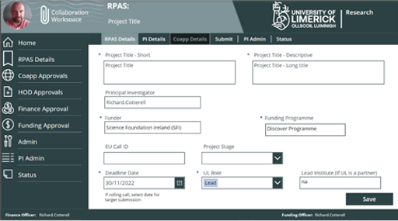
Research Proposal
Authorisation System (RPAS)
Proposals
    Online authorisation system for funding applications
    Web based system accessible from anywhere
    Collaboration workspace to allow development of proposal documentation on Sharepoint
    E-mails sent to CoApps, HoD, Finance & Funding Officers when action needed
    Mark proposal as Awarded/Not Awarded to complete
    Link to system and training documentation on the Research Portal
    Contact RPAS@ul.ie
Notes:
11

Slide 12

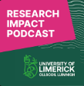
Research Impact at University of Limerick
Strategic Plan (2015-2019, UL@50 2019-2024, Research Strategy 2016-2020, Research Strategy Wisdom for Action 2022-2027)
UL’s Research Impact programme has been singled out by the OECD as “an excellent example of emerging good practice which could be mainstreamed across the Irish higher education system and abroad.” *
Research Impact committee
President’s Research Excellence and Impact Awards
Case Study Programme
External Engagement & Research Communications
National Fora – Research Impact & Campus Engage
Research Impact Officer, Yvonne.Kiely@ul.ie, researchimpact@ul.ie

Slide 13
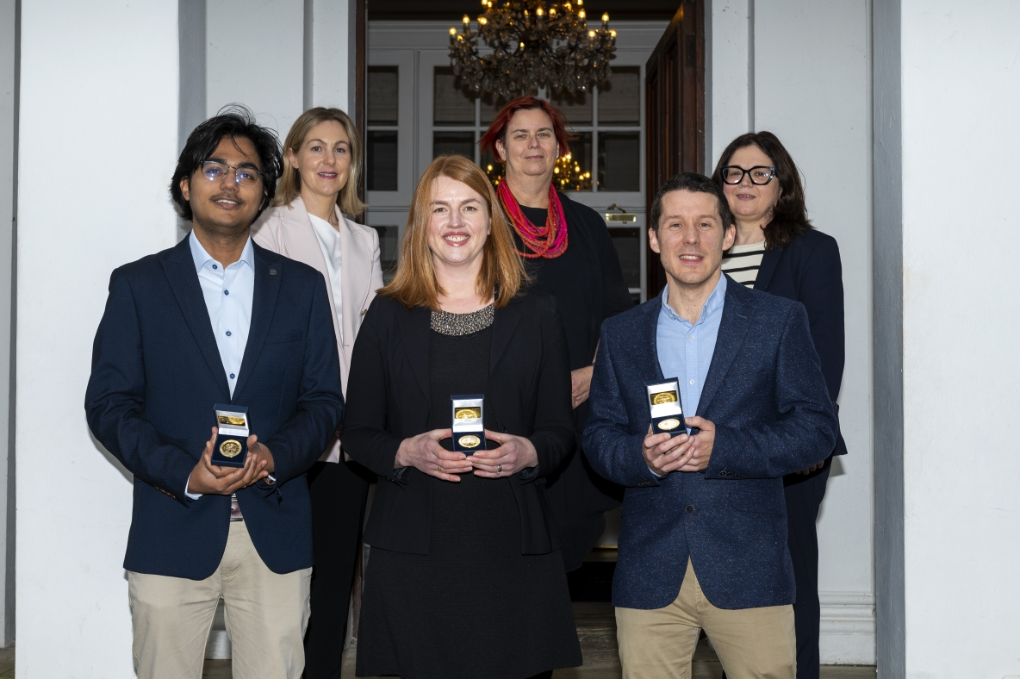
President’s Research Excellence and Impact Awards
Early Career Researcher – Starter
Starter: applicants have between 2-7 years’ experience since completion of their PhD as of the closing date for applications.
Early Career Researcher – Consolidator
Consolidator: applicants have between 7-12 years’ experience since completion of their PhD as of the closing date for applications.
Outstanding Research Collaboration
This award celebrates the achievements of research collaborations by recognising their excellent research that delivers impact and an outstanding contribution to their field
Research Output Award
Starting, Consolidator, Advanced, (greater than 12 years post PhD), Interdisciplinary

Slide 14
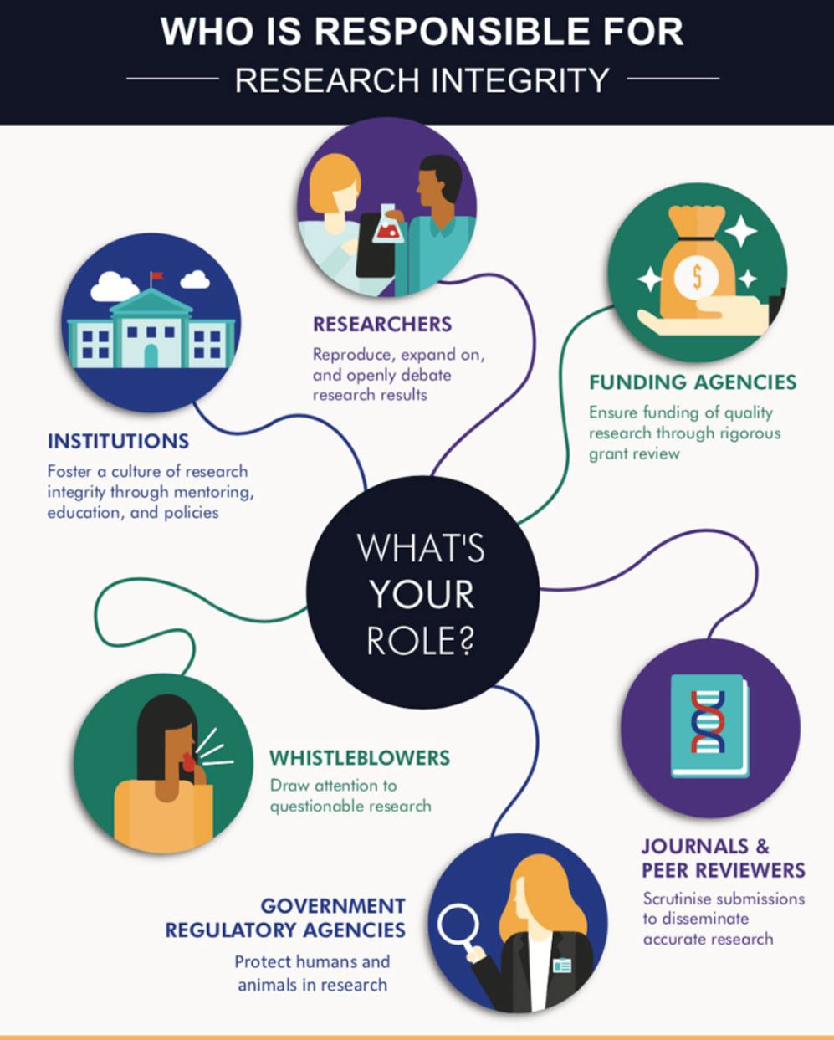
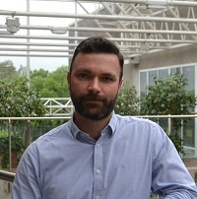
What is research integrity?
Research Integrity Officer
Prof Natalia Kopteva
Research Integrity Champions
Faculty of Arts, Humanities, and Social Sciences: Prof. Neil Robinson, neil.robinson@ul.ie
Faculty of Education and Health Sciences: Dr Elaine Kinsella, elaine.kinsella@ul.ie
Kemmy Business School: Dr Deirdre O'Loughlin, deirdre.oloughlin@ul.ie
Faculty of Science and Engineering: Dr Mícheál Scanlon, Micheal.Scanlon@ul.ie
Dr Barry Shanahan
Research Governance Officer, supporting the implementation of policies in the areas of research integrity, research ethics, and general research oversight. Online research integrity training is available to all members of campus community and is mandatory for new research hires. Note that funders can require evidence of training.

Slide 15


Slide 16
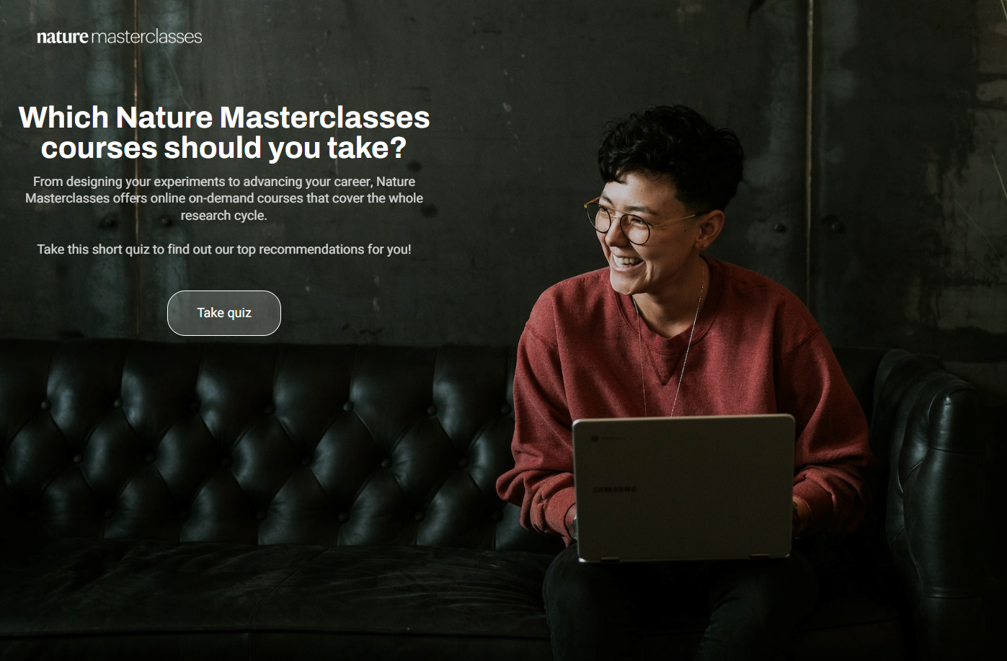
UL institutional subscription can be accessed via
masterclasses.nature.com

Slide 17
Thank you!

