Slide 1
7 Steps for Assignment Success
BY
Peter.Reilly@ul.ie

Slide 2
Originally Adapted from

Slide 3
7 Steps to Assignment Success
Always Reference Sources
Define scope of Topic
Think what resources to use
Develop a Research Strategy
Use Boolean Search Techniques
Critically Evaluate Results
Use Reference Management Software

Slide 4
Learning Outcomes
Awareness of range of library resources
Confidence in using resources
Able to develop research strategy
Critically evaluate information
Developing lifelong learning skills

Slide 5
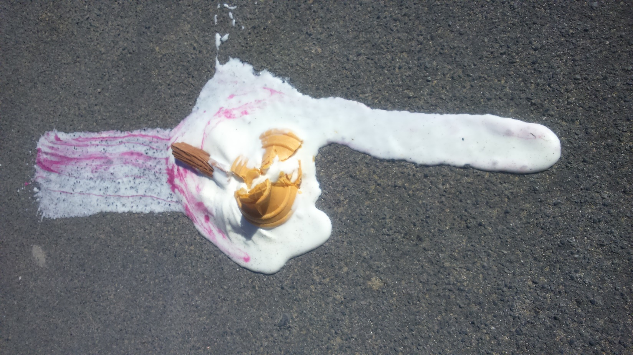
Ice Breaker Task
Describe in Key words

Slide 6
Step No 1
Define scope of Topic

Slide 7
Thinking Strategies

Slide 8
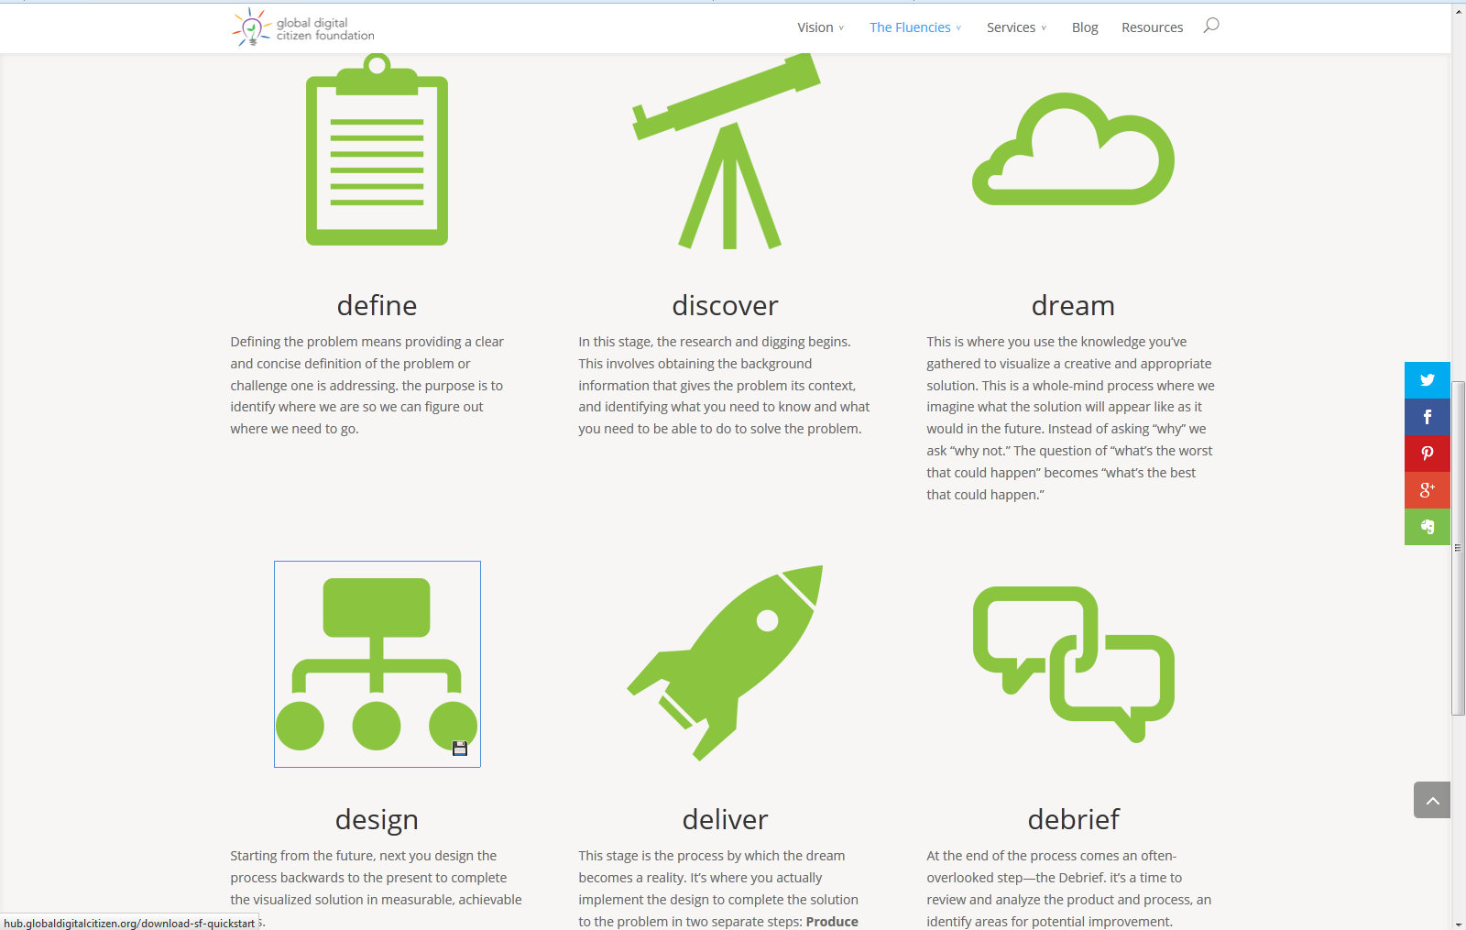
Apply 6ds of Solution Fluency to Research Process
https://globaldigitalcitizen.org/
Notes:
Solution Fluency is a creative approach to problem solving developed by the Global Digital Citizen Foundation.
It is a six step process known as the “6 Ds” and students are encouraged to consider it as another lens in which to view their dissertation.

Slide 9
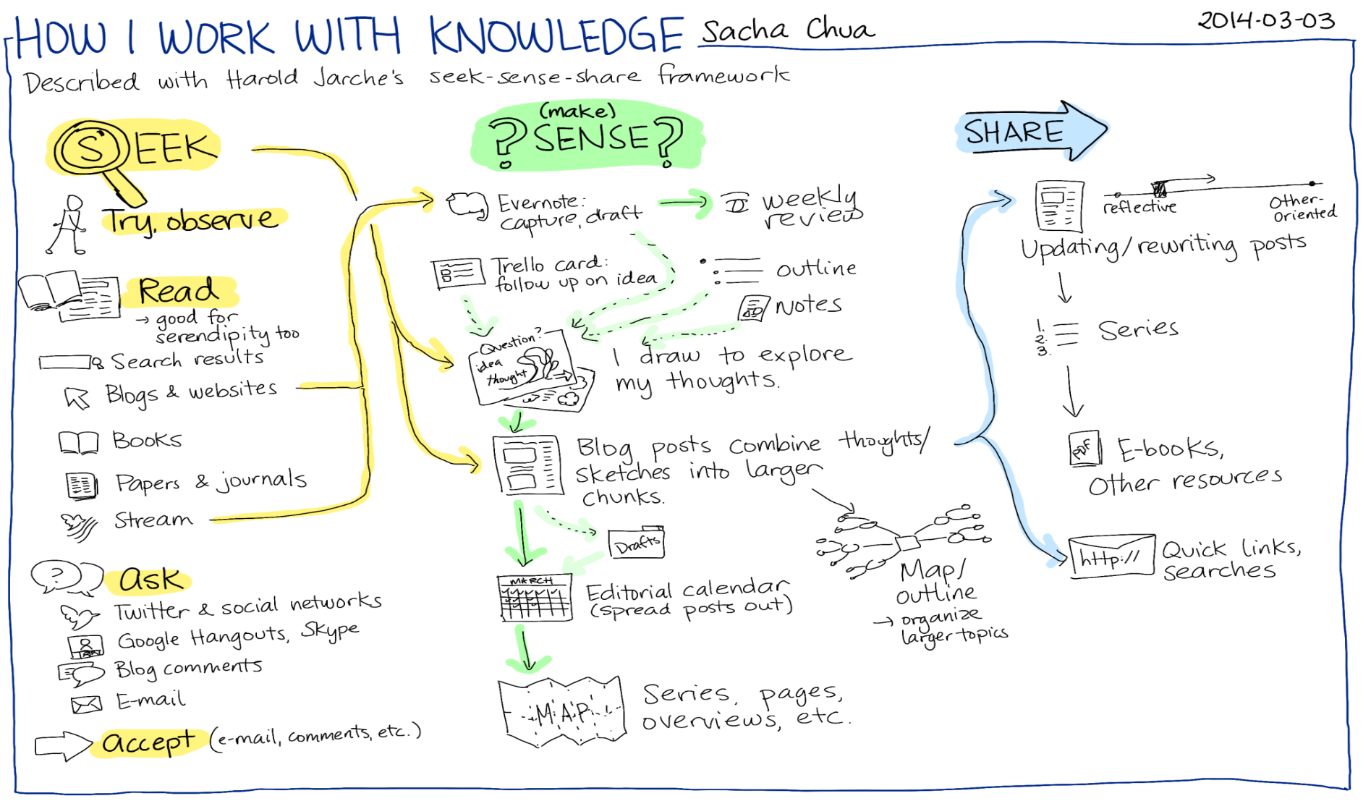
Visual Presentation of Research process
https://www.flickr.com/photos/sachac/12918711723/
Notes:
This is another visual presentation of the Seek Sense Share model created by Sacha Chua.
Students really engage with it because it is easy to follow, and can relate it to their own Literature Review.

Slide 10
Step No 2
Think what resources to use

Slide 11
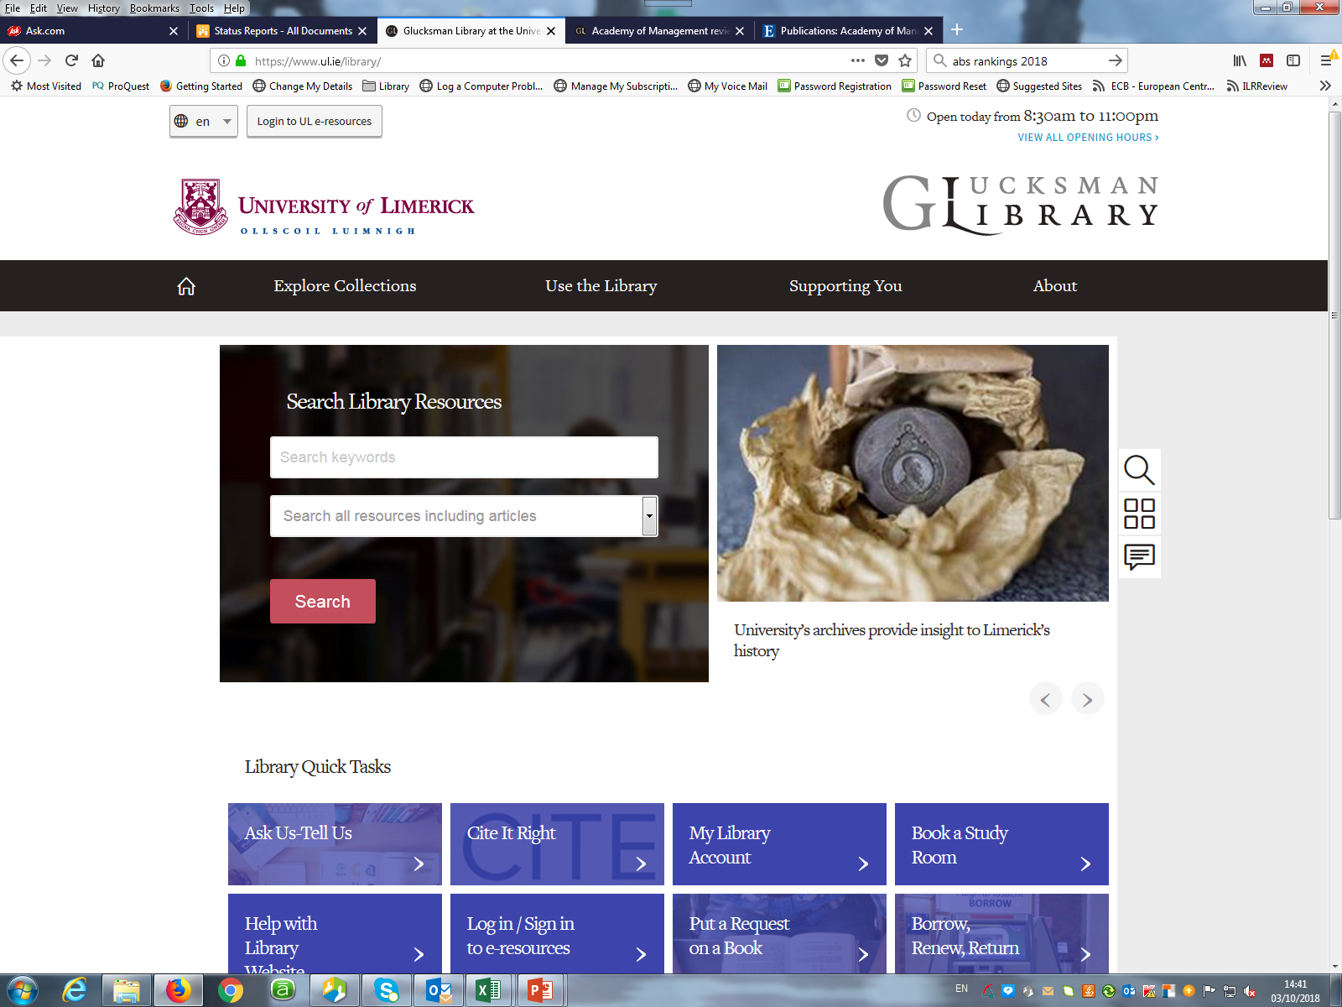
Search Library resources

Slide 12
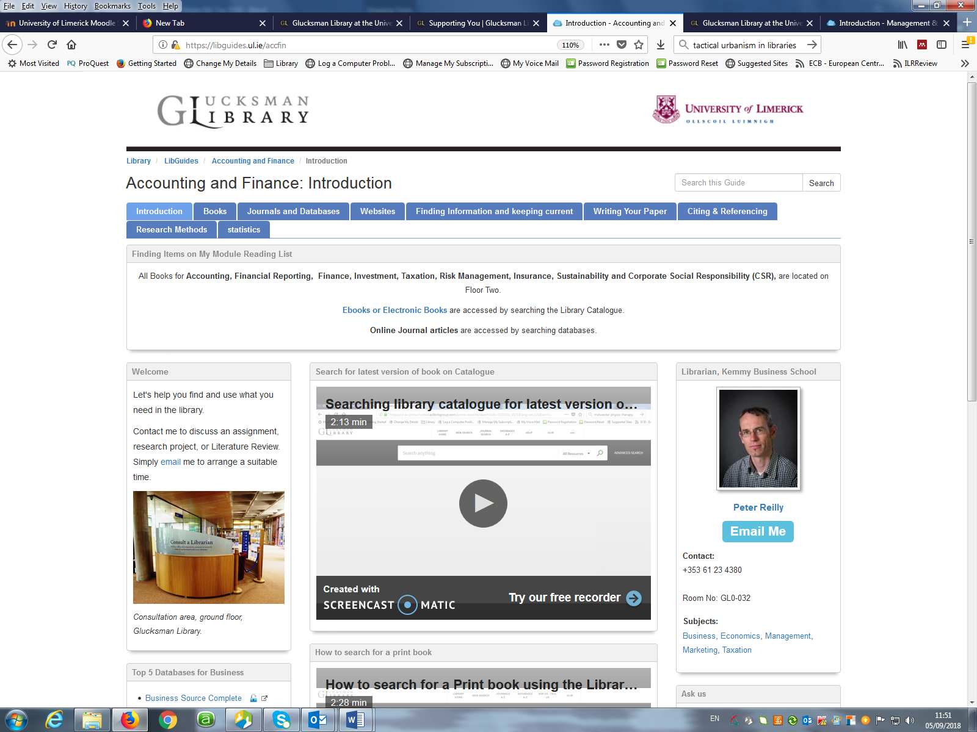
LibGuides for Each Subject

Slide 13
Practical Task
Search for a Journal
“Australasian Journal of
Educational Technology”
2016, Vol 32 issue 4

Slide 14
As already know title of Journal,
Quickest method
Use the Journal Search option

Slide 15
Conduct database search one of the following topic
Digital literacy
Or
Critical Thinking,
Or
Health Apps

Slide 16
For This Example
We selected “Health Apps”

Slide 17
Step No 3
Develop a Research Strategy

Slide 18
Think in Terms of
Keywords

Slide 19
Related Search Terms/ Keywords
Health Apps
Analytics
costs
Risks/ Privacy
Artificial Intelligence

Slide 20
Step No 4
Use Boolean Search Techniques

Slide 21
Boolean Search Terms:
And = Narrows
Or = Expands
Not = Excludes

Slide 22
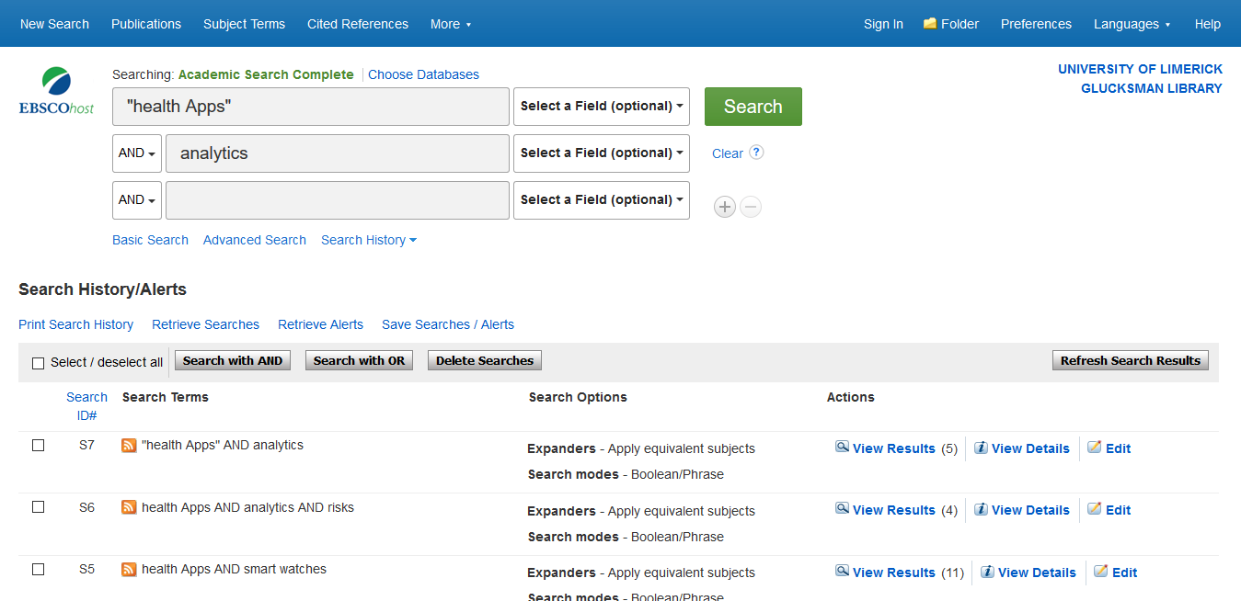
Example of Boolean Database search

Slide 23
Viewing things Differently,
makes them more interesting

Slide 24
Always adopt a Holistic View to your assignment
Instead of Analytical one
Assignment

Slide 25
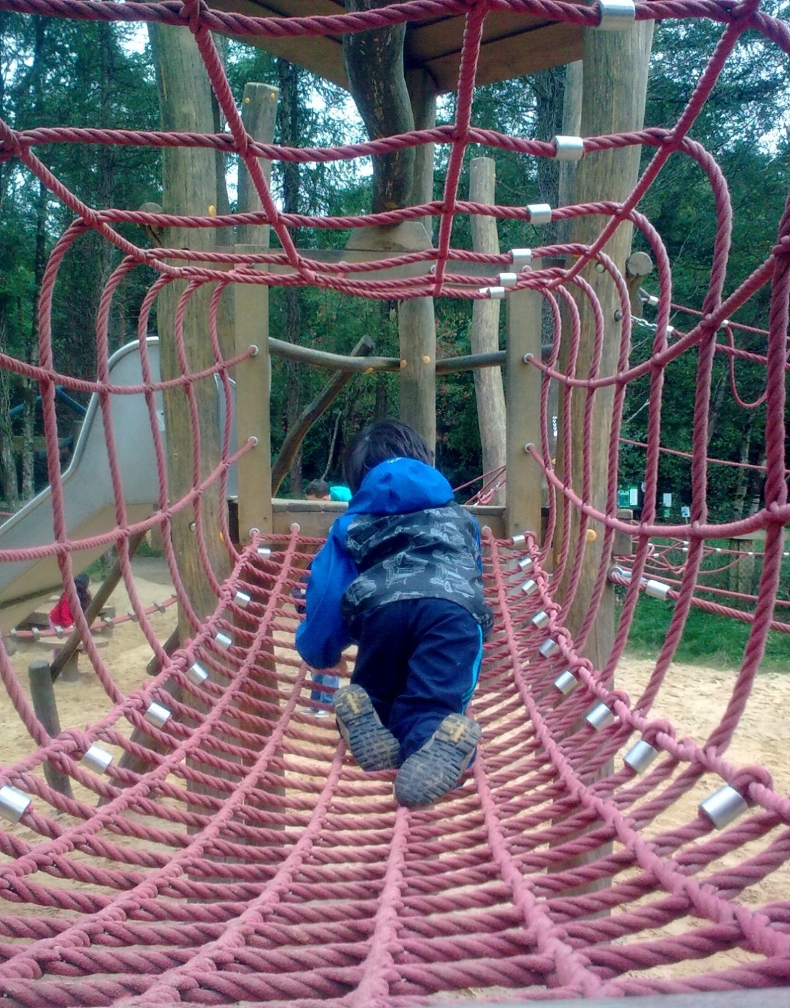
Makes
Your Research more
interesting to
The Reader

Slide 26
Step No 5
Critically Evaluate Results

Slide 29
Apply CRAAP Test
CRAAP TEST
Currency
Relevance
Authority
Accuracy
Purpose
https://library.csuchico.edu/sites/default/files/craap-test.pdf

Slide 30
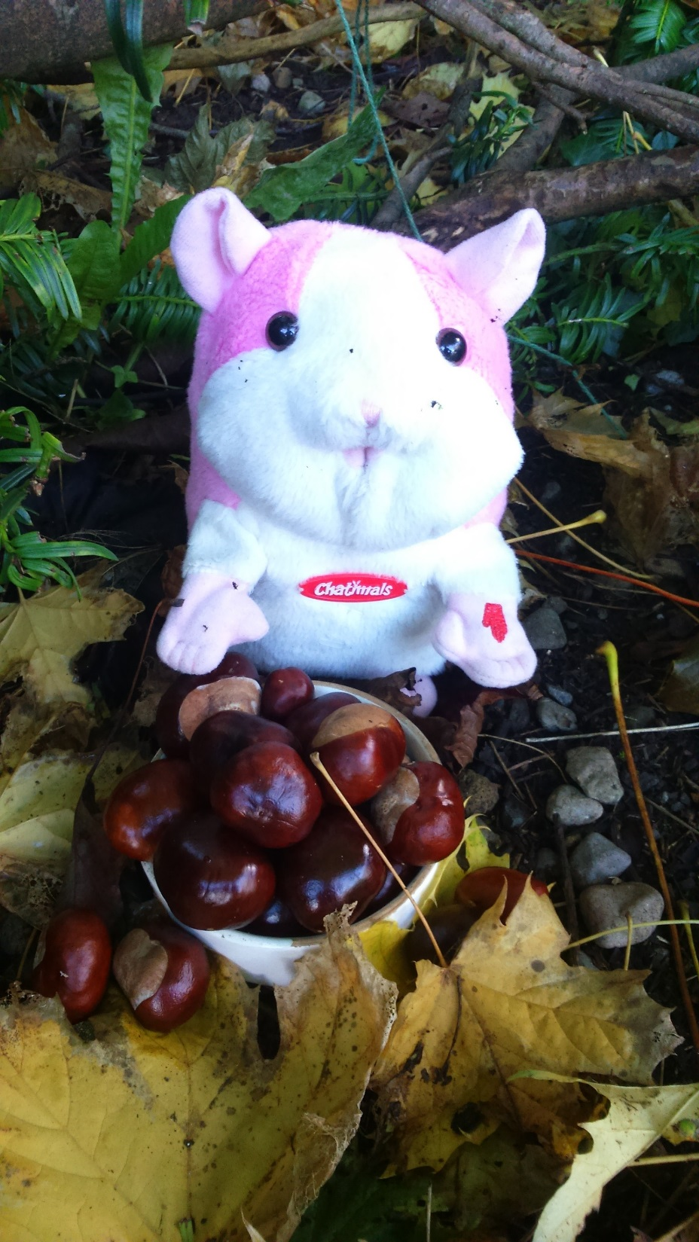
Review what you already have
Before Collecting more papers

Slide 31
Step No 6
Use Reference Management Software
Attend Endnote Workshops

Slide 32
Step No 7
Always Reference Sources
Sign up for
Referencing Workshops

Slide 33
Quick Recap of 7 Steps
Always Reference Sources
Define scope of Topic
Think what resources to use
Develop a Research Strategy
Use Boolean Search Techniques
Critically Evaluate Results
Use Reference Management Software

Slide 34
Recap of Learning Outcomes
Awareness of range of library resources
Confidence in using resources
Able to develop research strategy
Critically evaluate information
Developing lifelong learning skills

Slide 35
Final Reflection
Write Down 2 Things
From this Session
Which help You

Slide 36
Thank you for your Attention. Peter.Reilly@ul.ie Learning & Engagement Librarian (KBS)
ul.ie

