Slide 1
HR Induction for New Staff
Professor Kerstin Mey
President

Slide 2
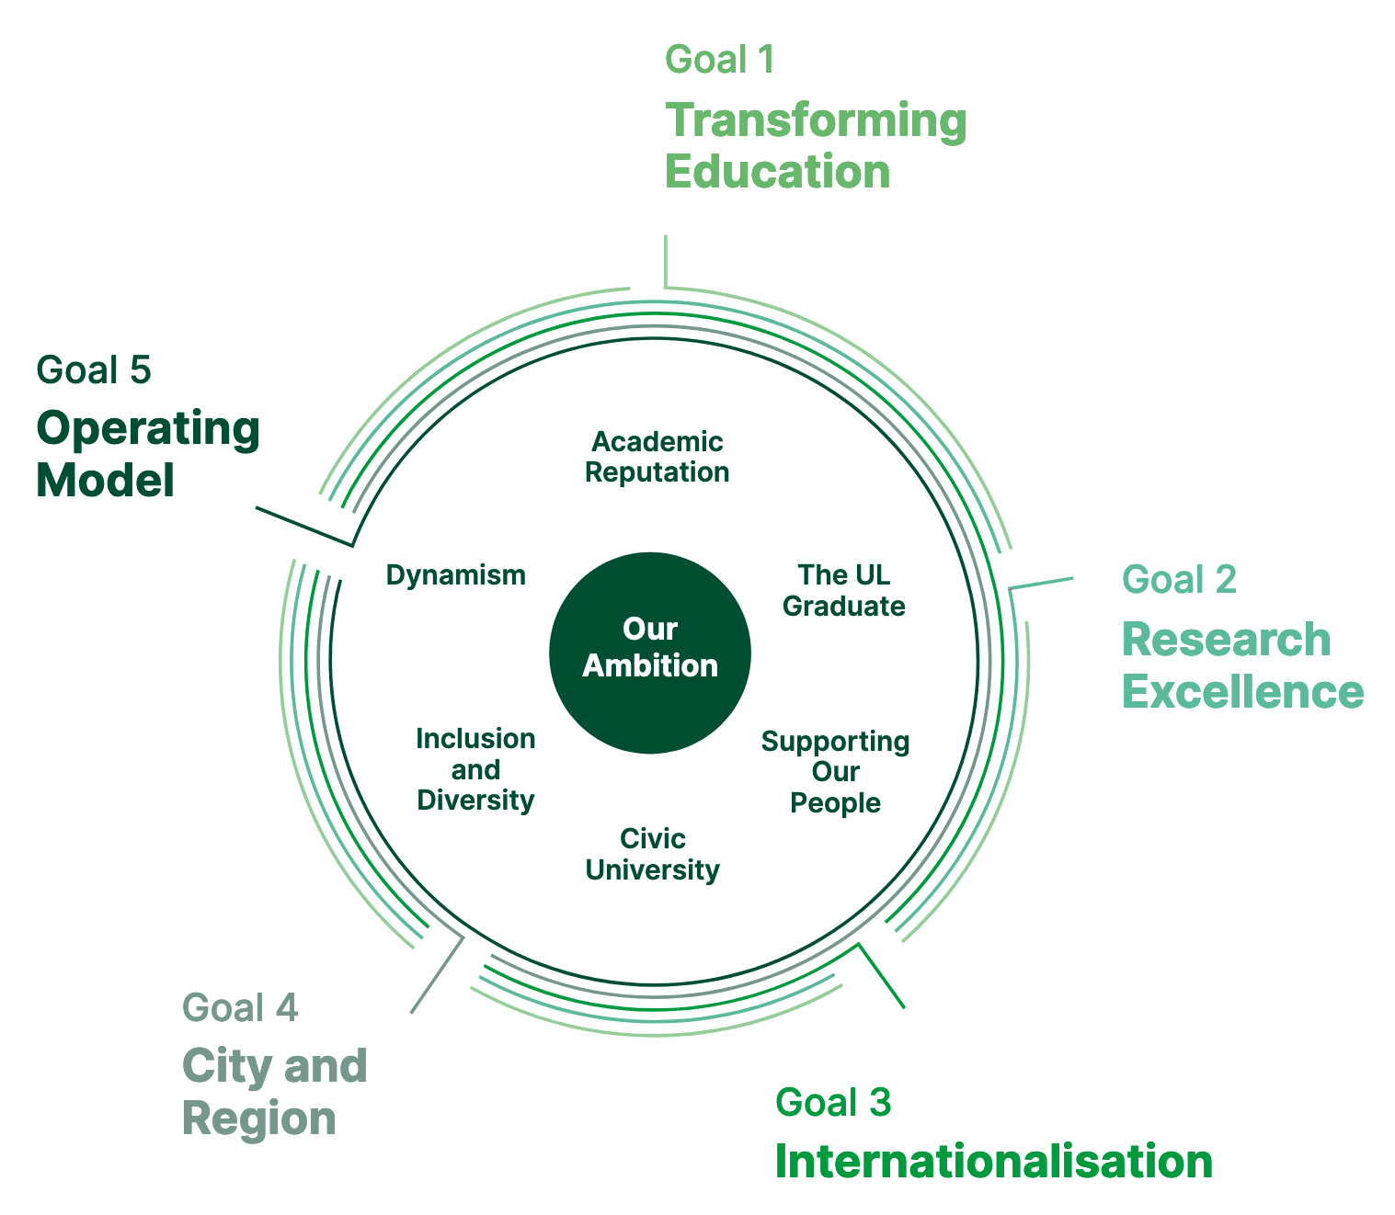
UL Strategic Plan: UL@50
Launched November 2019
Covers period 2019-2024
5 key goals
Recalibration in the context of Covid19 and changing external contexts:
DFHERIS
Technological Universities
Brexit
Horizon Europe (FP9)
HEA Bill 2022
Funding reform
New Research + Innovation Strategy
Green
Notes:
2
I would like to use the consultation on UL@50, to share some thoughts on the context in which we review our strategic emphases to enable UL to continue to thrive.
Since the Strategic Plan was launched a year ago, much has changed in UL, in Irish society and globally. The world will be different once the Covid19 pandemic abates. Acknowledging and responding to the changes requires that we review our Strategic Plan, that we pivot it as necessary, that we recalibrate our objectives and re-determine our key performance indicators.
Given the volatility of the current situation and the speed and profound nature of the changes, we have to have a strategic plan that enables us to dynamically respond to challenges and opportunities externally and internally, that safeguards that UL strengthens its academic and research excellence, enhances its national and international visibility and reputation, remains sustainable, acts as a catalyst for the transformation of the region and contributes to building an inclusive and prosperous society.

Slide 3
Strategic Plan: UL@50
Campus consultation process as tool
Granularity of objectives
Agreed KPIs
3-year rolling planning cycle
Annual budget setting process and operationalization plans
EC Roadshows
Green
Notes:
3

Slide 4
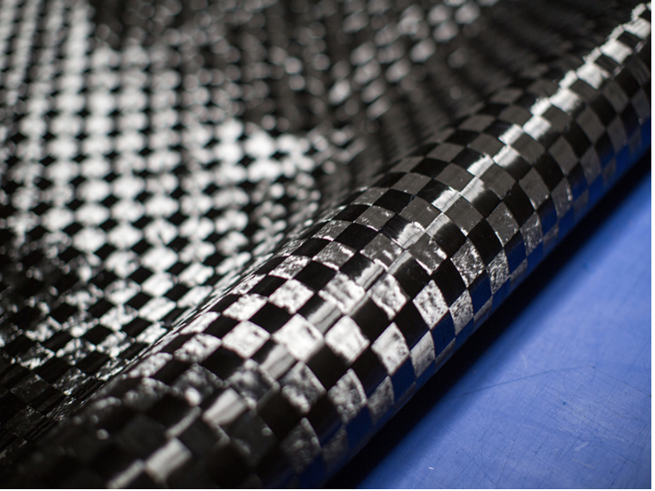
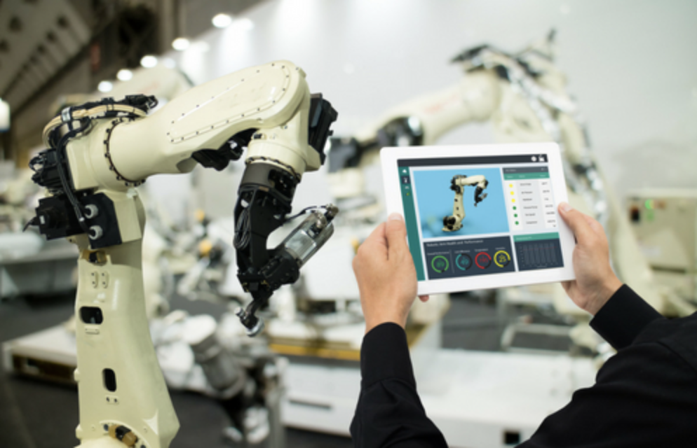
UL Context
UL Institutional Review – Cinnte Report (Published 01/2021)
Accelerated move into digital teaching, learning and research over the past 24 months: return to campus with continued hybrid delivery model, application of lessons learned from C19
Research-led university: need to grow research performance: high quality publications, international co-authorship, citations, networks, funding
YERUN membership, eMERGE consortium
Educational Transformation Programme
Success in HCI Pillar 3: UL@ Work: advanced digital skills programmes in collaboration with industry; modular re- and upskilling offers, micro-credentials, ISE commencement; 8 apprenticeships to level 10
City campus, main campus + SDZ developments
Notes:
4

Slide 5
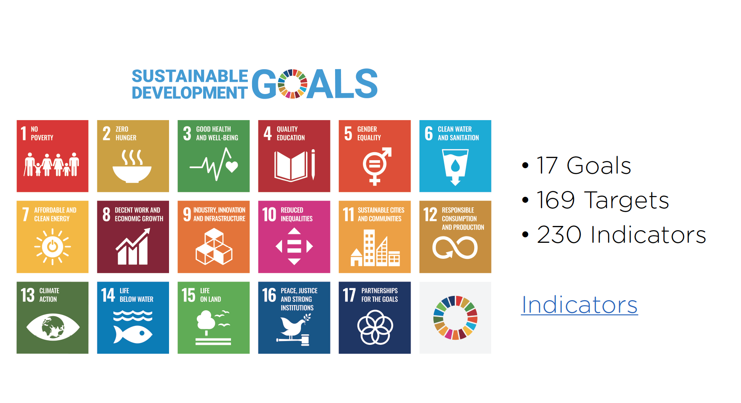
UL Sustainability Framework 2030 – Autumn 2022 launch
Embedding sustainability in everything we do
Bottom-up approach
21 UL Mission labs
Notes:
5

Slide 6
Thank you

