Slide 1




Induction Presentation 2023
HEALTH & SAFETY UNIT

Slide 2



Who You Need to Know in the H&S Unit
University Safety Officer and Head of the Unit ext 2239 Mob: 086 1072153 - Rob.Hickey@ul.ie
Grainne O’Carroll – Health & Safety Technical Officer ext 2074 grainne.ocarroll@ul.ie
Maggie Hayes – Health & Safety Technical Officer ext 2429 maggie.hayes@ul.ie
Freya Flynn - H&S Administrator ext 2374 Freya.F.Flynn@ul.ie
The Team are available for contact on MS Teams.

Slide 3
Our Role
Advising on Occupational Safety, Health & Welfare
  Conducting H&S Inspections
  Conducting H&S Assessments (DSE, Manual Handling etc.) as required
  Provision of H&S Advice to Departments
  Developing H&S Policies & Plans
  Co-ordinating H&S Training
  Advising on Fire Safety
Conducting Staff Garda Vetting email ulstaffgardavetting@ul.ie
Overseeing Child Safeguarding
Co-ordinating Wellbeing (Bewell@UL)

Slide 4
Your Role
Employees must:
Protect their own safety and health and that of anyone who may be affected by their acts or omissions at work.
Not be under the influence of any intoxicant.
Cooperate with their employer with regard to safety.
Not engage in any improper conduct.
Participate in safety and health training.
Make proper use of all machinery, tools, substances, etc. and of all Personal Protective Equipment provided for use at work.
Report any defects in the place of work, equipment, etc. which might endanger safety and health.
Report accidents and incidents as soon as possible to your supervisor or manager. Your supervisor or manager should complete a
First Aid Form, Accident Report Form or Dangerous Occurrence Form
UL CAMPUS EMERGENCY NUMBER= 3333/ 061 213333

Slide 5
Fire Safety
If you discover a fire:
Break the nearest fire alarm call point
Dial 999/112 to alert the emergency services
Dial 3333 – internal campus emergency number
If the fire is small, contained and you have been trained consider using the nearest appropriate appliance provided.
Do not take unnecessary risks
Evacuate
If the fire alarm sounds:
Leave the building by the nearest exit point, don’t delay to pick up personal belongings
Do not use the lift
Assemble at the Assembly Point for the building.
Follow the Emergency Evacuation Stewards instructions and Do Not re-enter the building unless authorised
UL CAMPUS EMERGENCY NUMBER= 3333/ 061 213333

Slide 6
Misc. Safety Topics
Drive slowly – the campus speed limit is 40 km/h (25 mph)
Child Safeguarding + Garda Vetting & Foreign Police Clearance Policy for those carrying out relevant work with children and vulnerable persons.
Driving for Work Procedure: SX031.2 Driving For Work Procedure.docx (live.com)
Take care at pedestrian crossings - never assume cars will stop!
No smoking or vaping anywhere on the campus.

Slide 7
How We Can Support You
Safety inspections
Advice on safety improvements
Risk Assessments - All activities taking place on campus must be risk assessed (by your department or another competent person) and the risks reduced to an acceptable level.

Slide 8

How We Can Support You
The Employee Support Service (ESS) is a confidential counselling and advice service to assist all of us in dealing with personal issues that could pose a risk to our health, well-being, relationships and jobs.
Service is free to UL staff
Service is voluntary – the decision to use the service and avail of counselling rests with the individual.
The service is confidential and independent.
FREEPHONE: 1800 201 346

Slide 9


H&S Training & BeWell@UL
Health and Safety training is held throughout the year and includes courses such as First Aid Response, Manual Handling, Chemical Agent Risk Assessment, Evacuation Chair Training.
Please advise your Head of Department of your safety training needs and your Head of Department can them email us at hnsbookings@ul.ie
Be Well events are scheduled during the academic year. It is free service running H&S related and/or complimentary therapies. Take up is popular; look out for UL Connect announcements from: BeWell@ul.ie

Slide 10
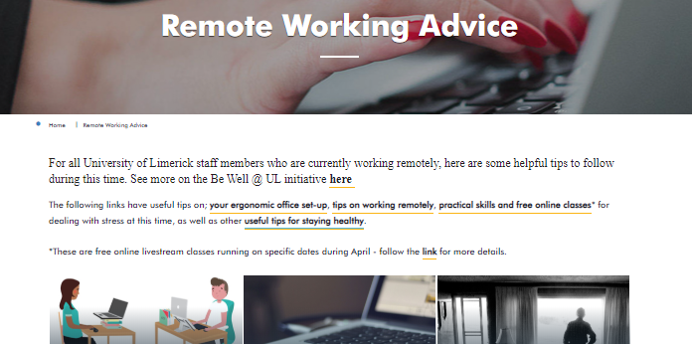
Working Remotely
You are required to review and comply with the current Policy and Procedure for Blended Working
Important Health and Safety Guidelines on keeping safe while working form home can be found at:
https://www.ul.ie/remote-working-advice

Slide 11
Safety Information Available
University Safety Statement- located on the UL Health and Safety Website.
Local Safety Statements and other Departmental sources- available from your Head of Department.
Health & Safety Essentials Booklet-located on the UL Health and Safety Website.
Your Safety Representative
HR Website: http://ul.ie/hr/health-safety-ul

Slide 12

COVID-19
Space Management Committee
Public Health Advice www.hse.ie
Know the symptoms
Hand & Respiratory Hygiene
High Risk and Very High Risk employees
C-19 Worker Representative
Reporting a positive case covid19report@ul.ie
Contact your Manager for additional information

Slide 13
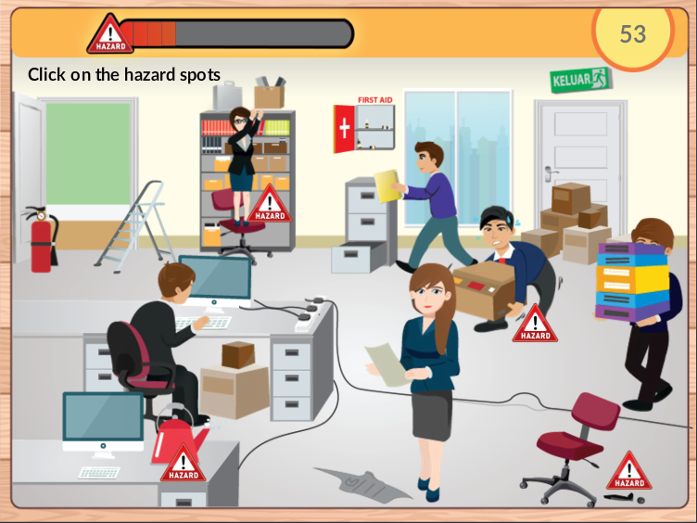
SPOT THE HAZARDS!!!

Slide 14



University of Limerick, Limerick, V94 T9PX,
Ireland.
Ollscoil Luimnigh, Luimneach,
V94 T9PX, Éire.
+353 (0) 61 202020
ul.ie
Thank you

