Slide 1
Welcome to IT Services @ UL
Information Technology Division

Slide 2

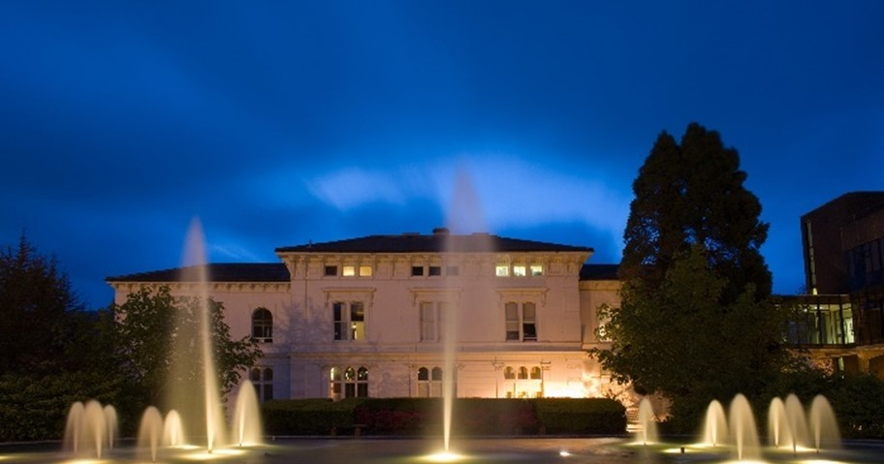

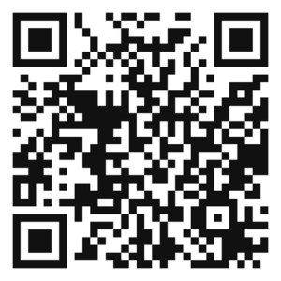
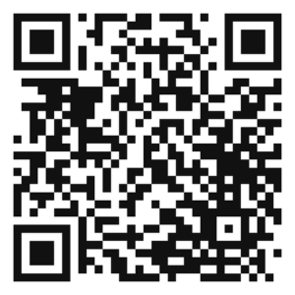
ITD Policy
The following policy documents outline the responsibilities of individual staff and student members:
University of Limerick Acceptable Usage Policy
University of Limerick IT Security Policy
A summary of the key elements of these policies is available on the ITD website within the Policies & Procedures section, along with all ITD supporting procedures referenced within.
Acceptable Usage Policy
IT Security Policy

Slide 3

Contact ITD
For 24/7 IT assistance visit ul.topdesk.net
Email us at service.desk@ul.ie
Call the Service Desk on 061 202999
The ITD Service Desk is located in the foyer of the Glucksman Library

Slide 4
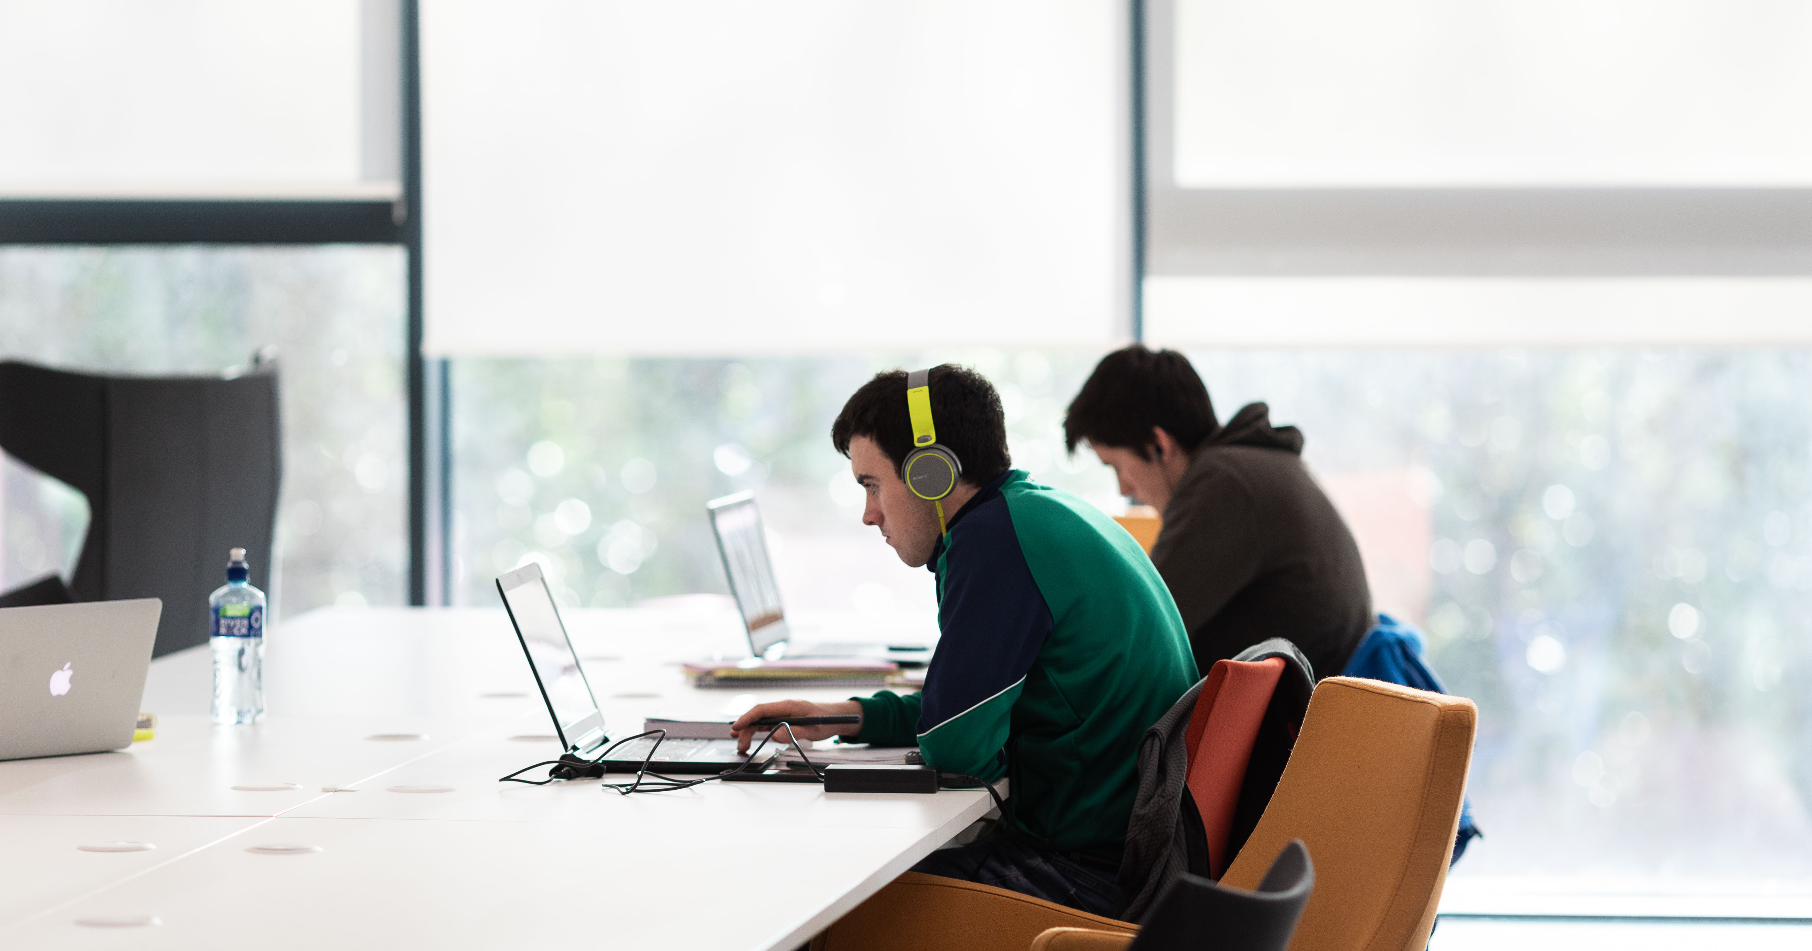
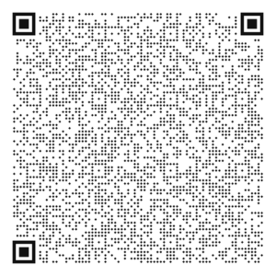
Staff Quick Start Guide
The Information Technology Division (ITD) is responsible for providing IT services & support to all staff and students.
ITD have created a Staff Quick Start Guide to introduce the key IT services available and help you get started using IT at UL.
Scan the QR code or visit www.ul.ie/itd and scroll to the Helpful Links section on the ITD homepage to find the Staff Quick Start Guide.

Slide 5
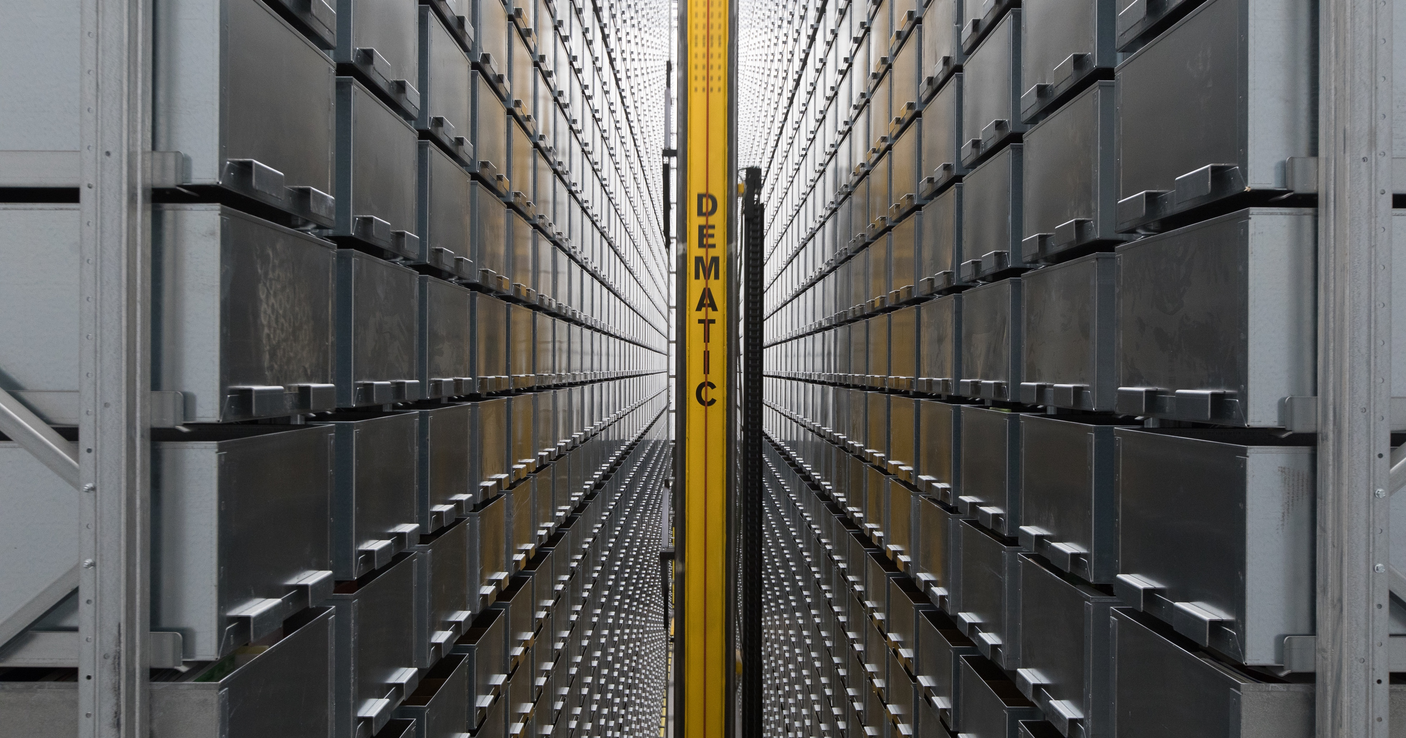
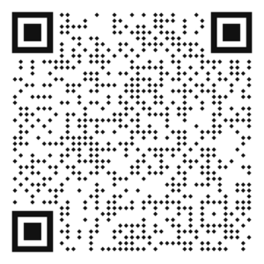
Self-Service Password Reset (SSPR)
To reset your password, follow the below steps:
Go to portal.office.com/ ​
Enter your email address​
Select ‘Can't access your account?​’
Follow the onscreen instructions
Scan the QR Code for further information on SSPR

Slide 6
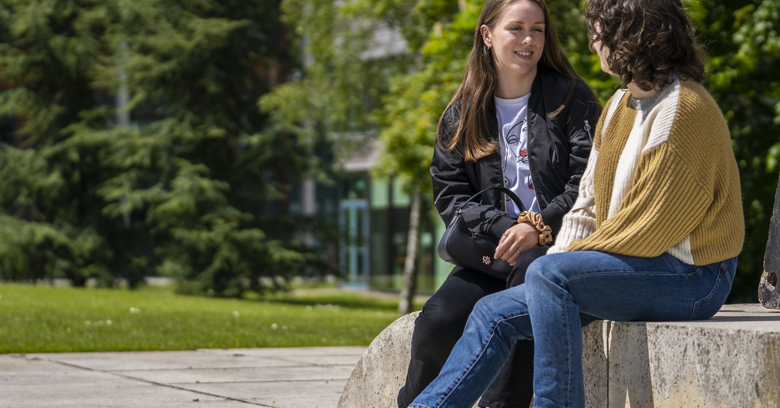
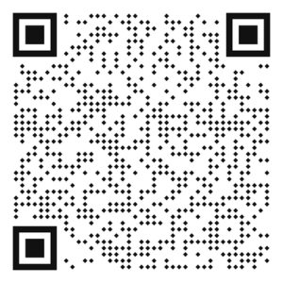
Multi-Factor Authentication (MFA)
MFA Adds another layer of protection when accessing all Microsoft Services.
Visit https://aka.ms/mfasetup to register for MFA.
Alternatively, scan the QR code to learn more about Password Management at UL.

Slide 7

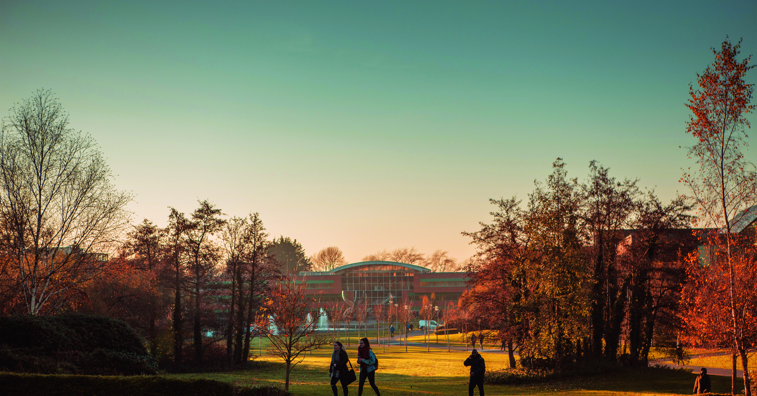
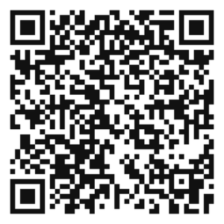
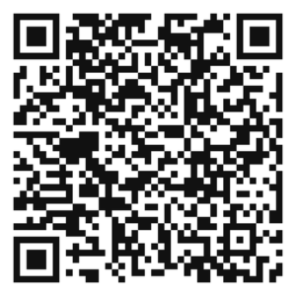
New Devices
If you have purchased a UL machine it will need to be setup by ITD. Request a device setup by visiting the Self-Service Portal (ul.topdesk.net) and clicking My Workstation → Computers & Laptops. Once you submit a Setup PC/Laptop request, an ITD technician will be in touch to arrange an appropriate time with you.
Blended/ Hybrid Working
An overview of remote working & and how to access services off-campus is available at ul.topdesk.net by clicking the Blended/Hybrid Working tile.

Slide 8
Personnel Self Service (Core)
In this section you can view and amend many of the personal details that are held on file with the University of Limerick including your address, contact and bank account details. For further information on this please contact the Compensation & Benefits Section - compandbens@ul.ie. ​
To access the Employee Self-Service site please visit www.ul.ie/essportal​
Please Note: You are required to register for a Core Account before logging in. A full guide can be found on UL’s HR website: How to Register for Core Portal​
Financial Online Services (Agresso)
Once you are a registered user the key financial services that are accessible online are:​
Student Fees Management System​
Staff Payroll system​
Staff Expense Payments, ​
Supplier Payments, ​
Budget Management​
Purchasing ordering and Good Receipting system​
Online Financial Reports​
Contact the Agresso Helpdesk for assistance or to arrange training email FinanceDept@ul.ie​
*If you are accessing these applications from outside the UL network please visit the Self-Service Portal → Blended / Hybrid Working → Remote Access for further information​

Slide 9
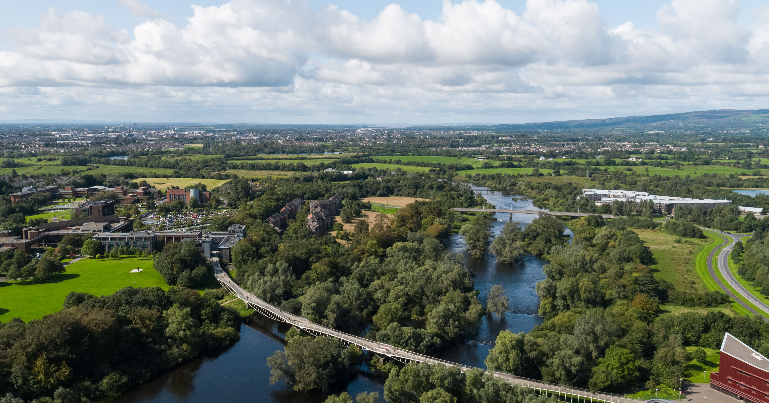
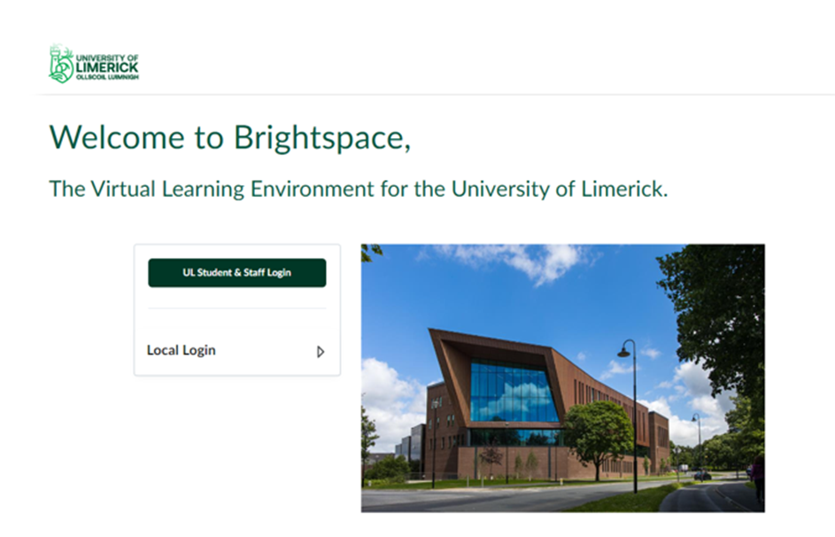
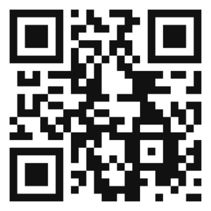
Brightspace
Brightspace is the University’s new Virtual Learning Environment. Brightspace is used to share content and facilitate online learning in UL.
Lecture content (videos, podcasts, slides, notes readings etc
Assignments
Online classes through BigBlueButton & MS Teams
Grading and feedback
Each lecturer will have their own teaching style so be sure to check with them on how they will use Brightspace in their module.

Slide 10

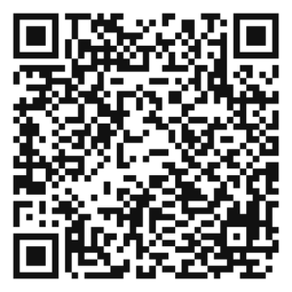
OneDrive for Business
OneDrive for Business enables users to securely share information and control levels of security via direct access or links for editing or viewing files.
The benefits of using OneDrive for Business are:
Automatically back up your files
View files from any device
Share securely and effortlessly
Simplified organization and discovery

Slide 11
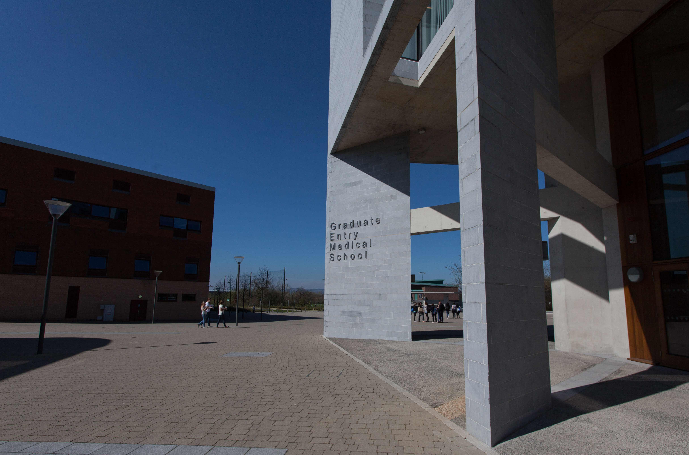
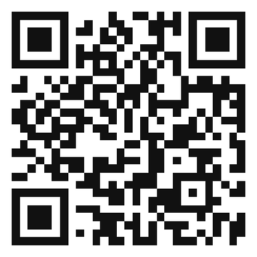
SharePoint
Most departments will have their own SharePoint site that houses departmental documents. The departmental coordinator will give you permission to the site and send you the link. To request a new SharePoint site, log a call with the ITD Service Desk.
To have a new site created, at least one person will have to be nominated as the Site Administrator.
To be a Site Administrator, the nominated person must complete the SharePoint Site Owner training course. These courses are run regularly by the HR Division.
Please contact HR if you wish to complete this training.
SharePoint Site Directory: https://ulcampus.sharepoint.com/

Slide 12
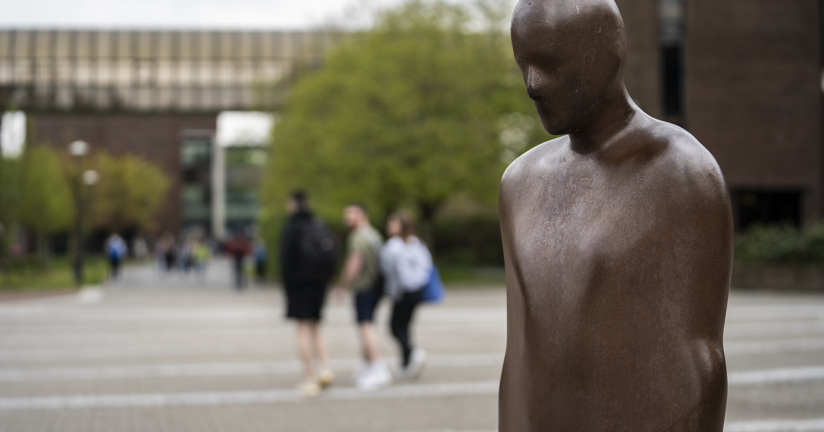
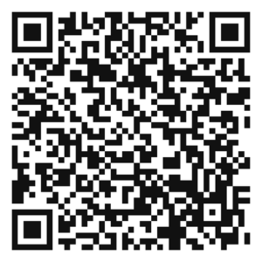
Office 365
Office is available for download through the Office 365 portal portal.office.com ​
You can download and install up to 5 copies of Office. To install additional site-licensed software please click here or scan the QR code below.

Slide 13
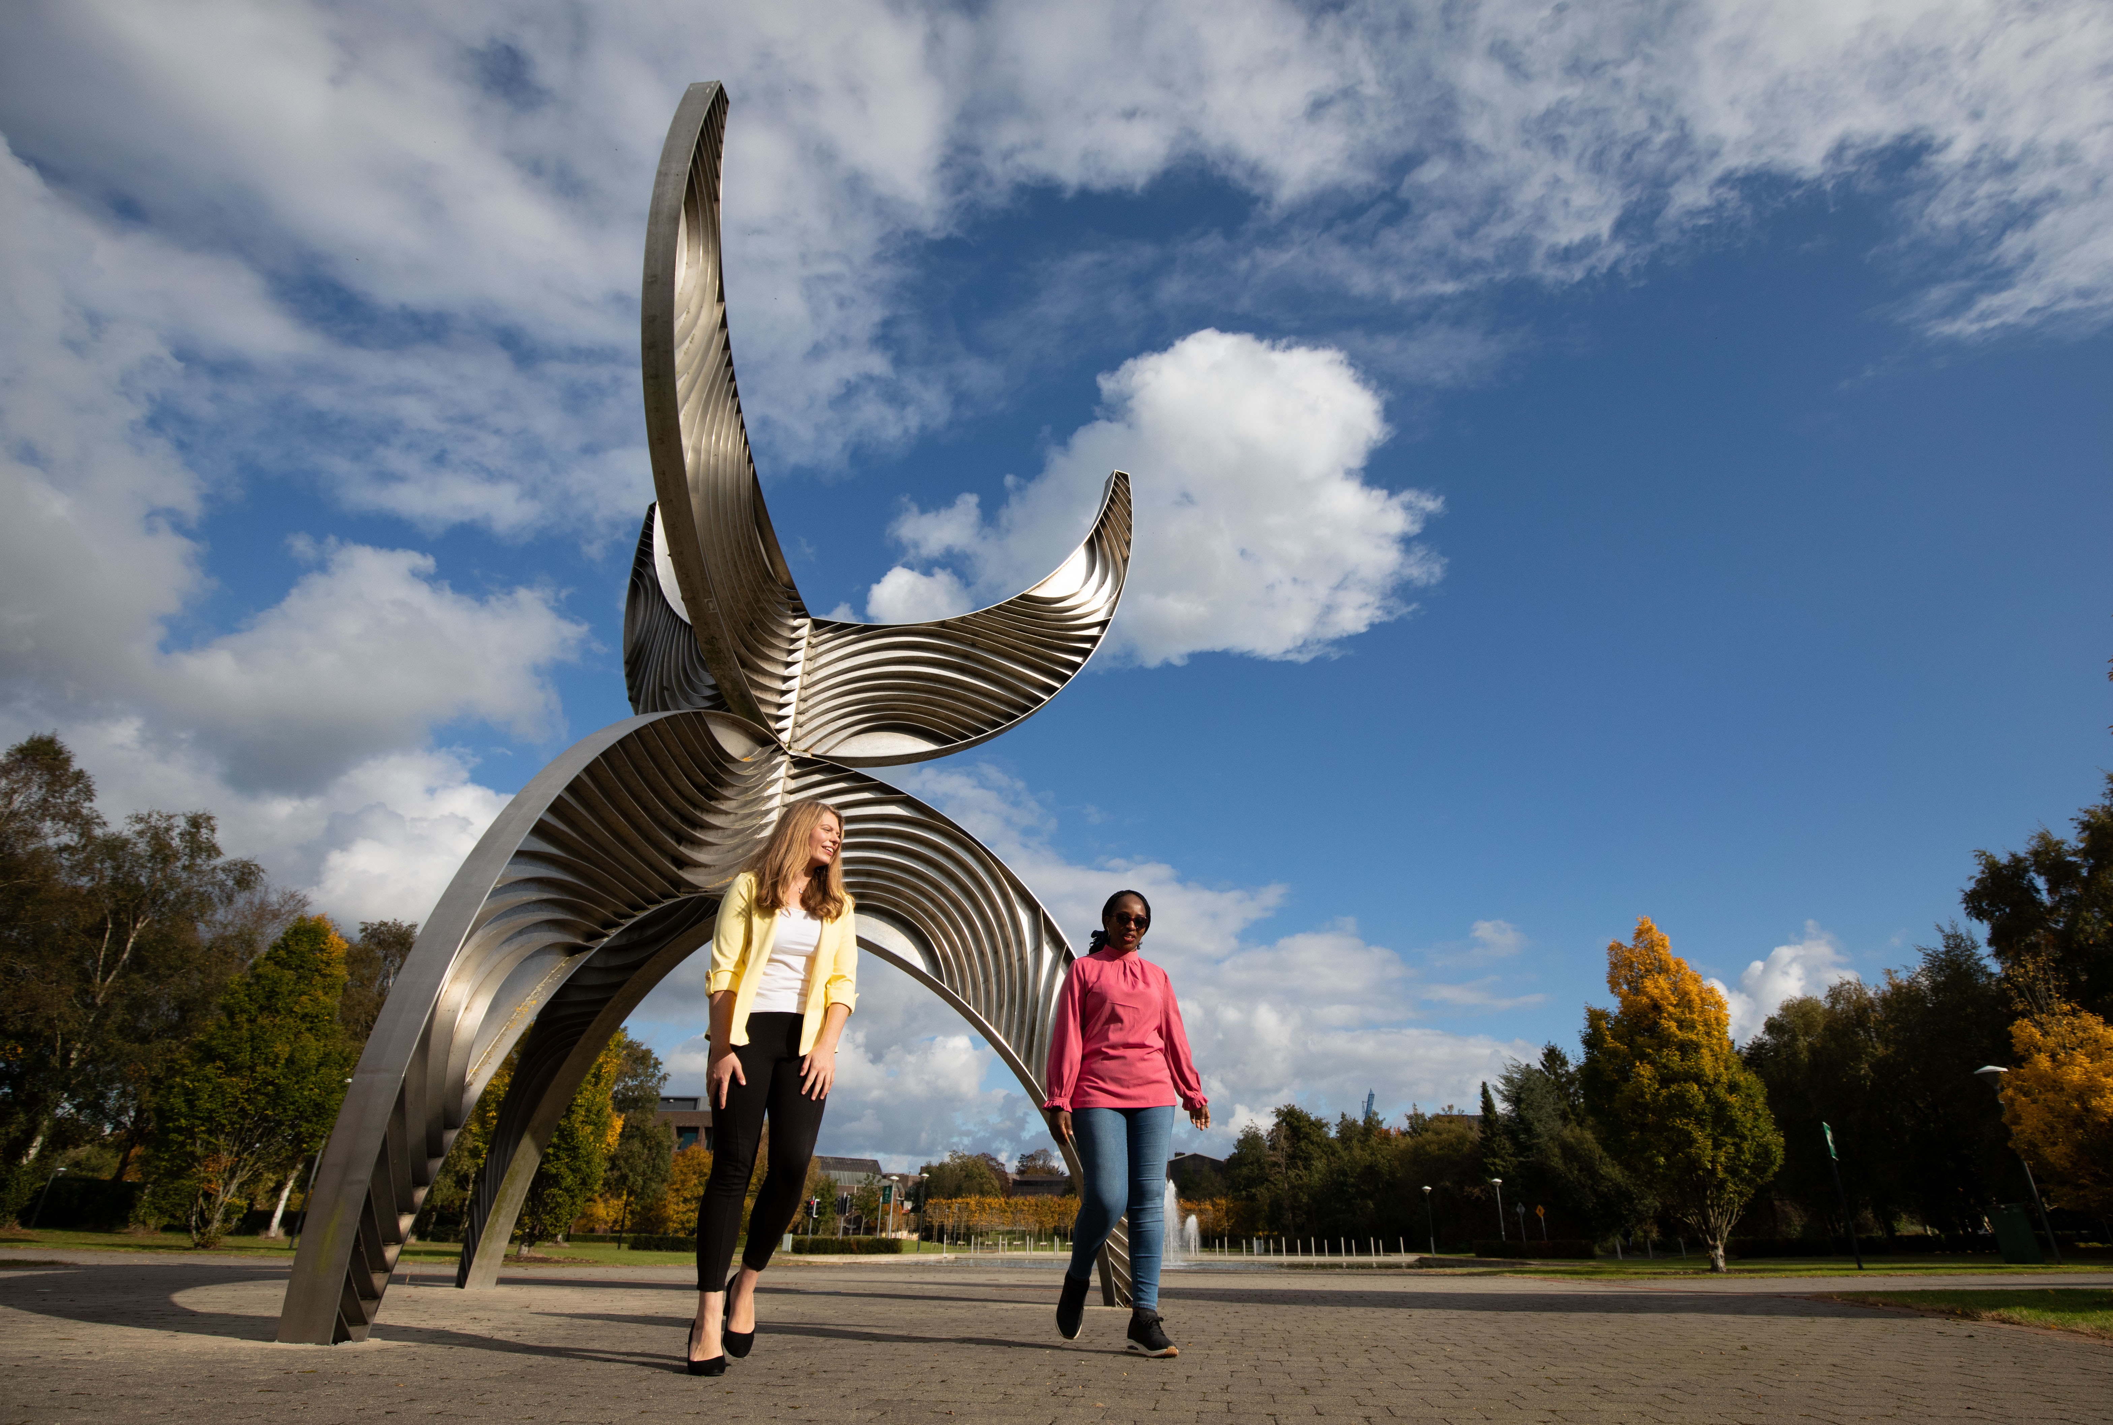
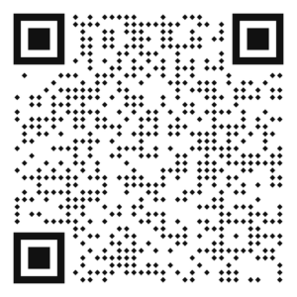
Connecting to campus WIFI (Eduroam)
Go to your WiFi settings and select Eduroam
Login with your UL staff credentials
e.g., firstname.lastname@ul.ieul.ie + password
What is Eduroam?
Eduroam is a secure WiFi service available to all staff and students in UL. Eduroam is also used by many other educational institutions so if you are studying or working abroad you can connect to the Eduroam network using your UL credentials (i.e., your username and password).
Scan the QR code for more information on connecting to WIFI

Slide 14

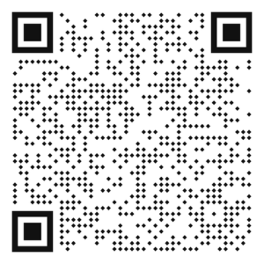
Staff Printing
Each department may have a number of network printers available for printing via the staff print queue. Once the print queue is installed on your PC and a document is sent to it, the document can be released/printed at your departmental printer by swiping your staff ID card at the printer in question.
Help on installing the print queue, setting a default printer and securely printing is available on the ITD website - www.ul.ie/itd/staff-it-services/staff-printing-services

Slide 15
Contact ITD at ul.topdesk.net if you have any questions or check out our website www.ul.ie/itd

