Slide 1
Staff Induction 2023 – IT Security
Edel Gissane
Notes:
Hi everyone,
My name is Rory Delaney and I’m the Head of the IT Security team here in UL. Over the next 10 minutes, I’m going to go over some of the key items from a cybersecurity perspective in UL and the main things that you should be aware of as part of your role.
I’ll give a brief overview of a handful significant cyber incidents that have happened last year just to provide some context but I’m going to start with a summary of the main things to note from this presentation.

Slide 2
Summary
All staff (and everyone in UL) are required to follow the IT Security & Acceptable Usage Policies
  These can be found in the UL Policy Hub and are approved by the Governing Authority
There are also a set of ITD Procedures, available on the ITD section of the UL website, that support the IT Security & Acceptable Usage Policies to deal with particular areas, such as:
  Passwords
  Use of Personal & Mobile Devices
  Email Management
  Network Access (e.g. connecting systems to the UL network)
  User Accounts
You should always report anything IT related that you think is suspicious or if you’re unsure please report it to the ITD Service Desk
  ITD will investigate all reports from users
  You should always report suspicious emails, even if they are obviously a phishing email. Reporting them enables ITD to remove these emails from all UL mailboxes
Limited Personal Use – UL resources (laptops, network, etc) must be used in line with UL Policies
Notes:
So these are the 4 key takeaways from this section –
1 – All staff & everyone in UL are required to follow the IT Security & Acceptable Usage Policies. These are available to review in the Policy Hub and you should take some time to familiarise yourself with them. The Policies are approved by the Governing Authority and are applicable to all staff in UL.
2 – There are also ITD Procedures which support the 2 policies and go into more specific areas. These are available on the ITD section of the UL website which is linked in this slide deck. Depending on your role, not all procedures will be relevant but the key areas that impact most end users are:
There is the UL Password standard – this sets out the minimum requirements for when selecting and using a password across UL accounts and systems
We have procedures on the use of Personal & Mobile devices – For example, it is not permitted to store sensitive or confidential University data on a personal device
Email Management – This documents the use of University email, that ultimately UL emails are the property of UL and also the steps required for an individual’s email account to be accessed by other staff.
Network Access – This would typically impact research staff who want to connect specialist devices to the UL network.
User Accounts – Sets out the use of user accounts and specific items, like how long until data stored in a user’s account is stored until delete
3 – In terms of IT Security, if you come across something you thing is potentially suspicious you should report it to ITD to investigate. Even if it’s obviously a phishing email you should still report it so that ITD can remove it from any other user’s mailbox.
4 – And lastly, keep an eye for any communications from ITD – for example on UL Connect. They typically relate to active cyber threats against the University to raise awareness or planned changes to systems to provide advanced notice to users.

Slide 3
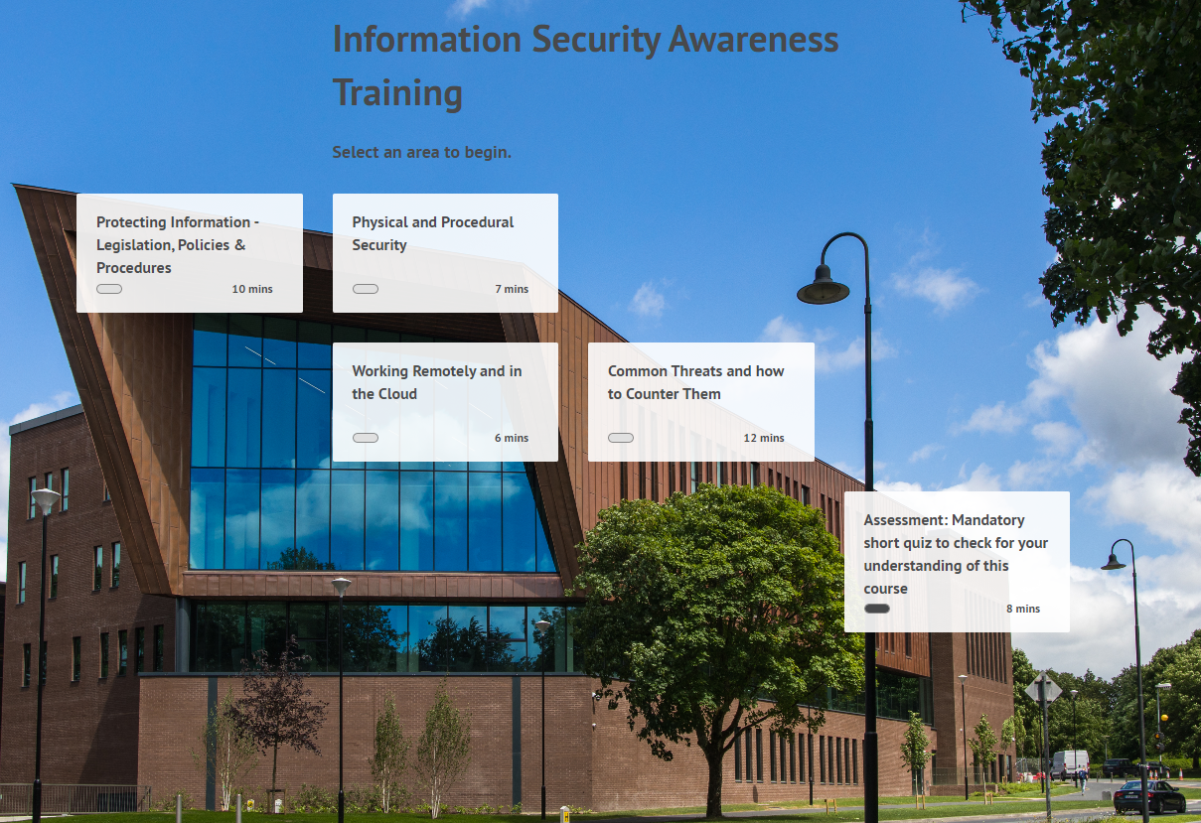
Information Security Awareness Training
UL staff are required to complete IT Security Awareness Training.
The training is available in Sulis (sulis.ul.ie) and covers:
UL IT Policies & Procedures
Common Threats & How to Counter Them
Physical & Procedural Security
Working Remotely & in the Cloud
Your standard UL account will log you into Sulis.

Slide 4
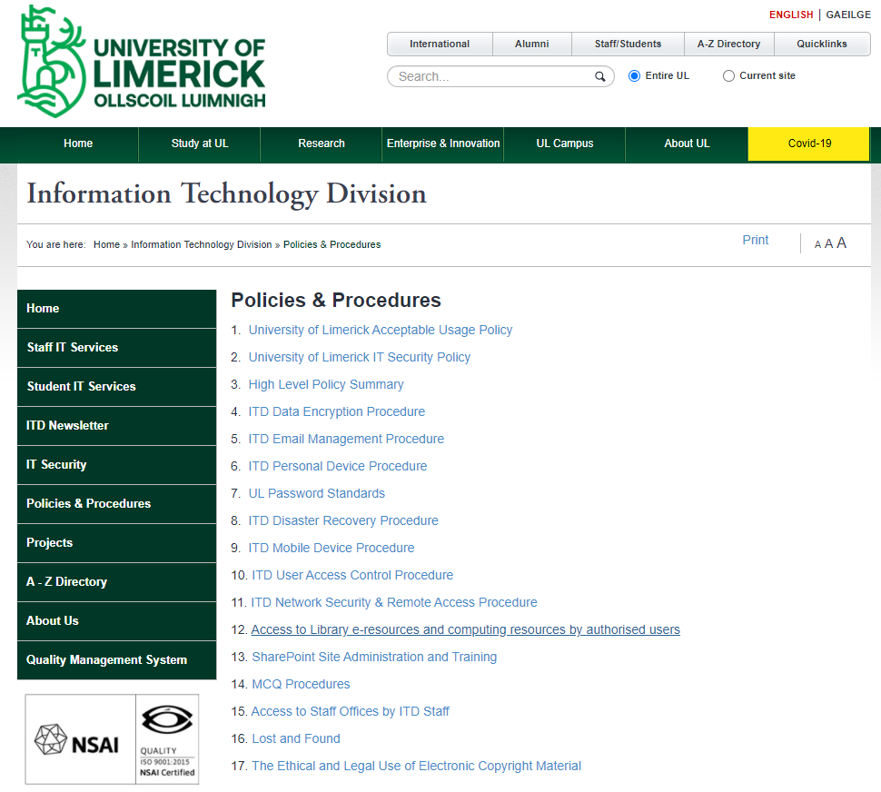

UL ITD Policies & Procedures
Policy Hub -
https://www.ul.ie/policy-hub/
UL Acceptable Usage Policy
UL IT Security Policy
ITD Procedures -
https://ulsites.ul.ie/itd/policies-procedures

Slide 5
UL ITD Policies & Procedures
Key Points
Users must not use any of the University's computing or network resources to make use of, or publish material that is obscene, libellous or defamatory or in violation of any right of any third party.
User accounts are for the exclusive use of the individual they have been allocated to.
  It is prohibited to provide your credentials to another individual or attempt to use another user’s credentials.
  ITD will never ask you for your UL credentials
All email accounts maintained on UL systems are the sole property of the University and in certain cases the University can access or/inspect a User’s email.
Users should report any suspicious behaviour (phishing emails, malware popups, etc.) to ITD immediately.

Slide 6
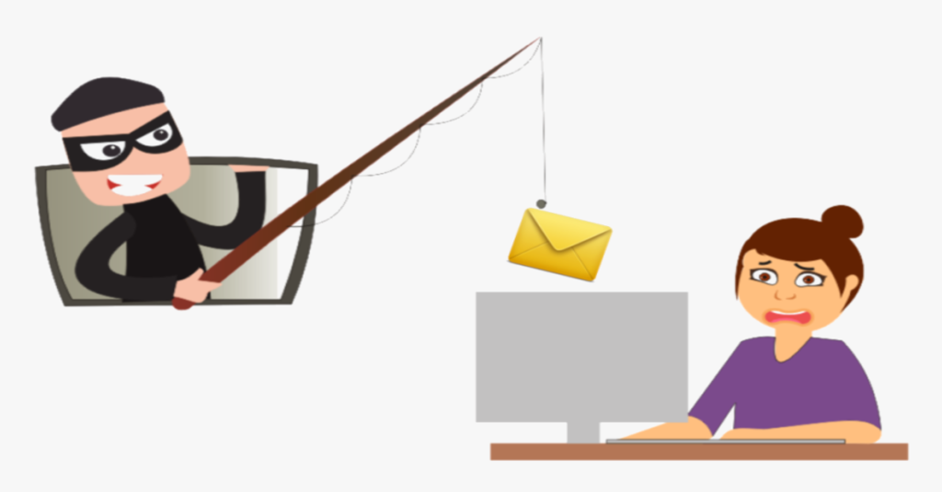
Watch Out For Phishing
  Phishing emails are an attempt to steal usernames and passwords, bank account details, credit card numbers or infect a computer with malware.
  The messages are designed to look like emails from legitimate, trusted sources and encourage recipients to click on a link or open an attachment. Some can be quite convincing but there are some steps to take to help protect yourself online.
  Basic Phishing Attacks often:
  Have generic greetings
  Request personal info such as your password or bank details
  Are short, vague or just odd
  Have unexpected attachments
  Have poor spelling or grammar

Slide 7
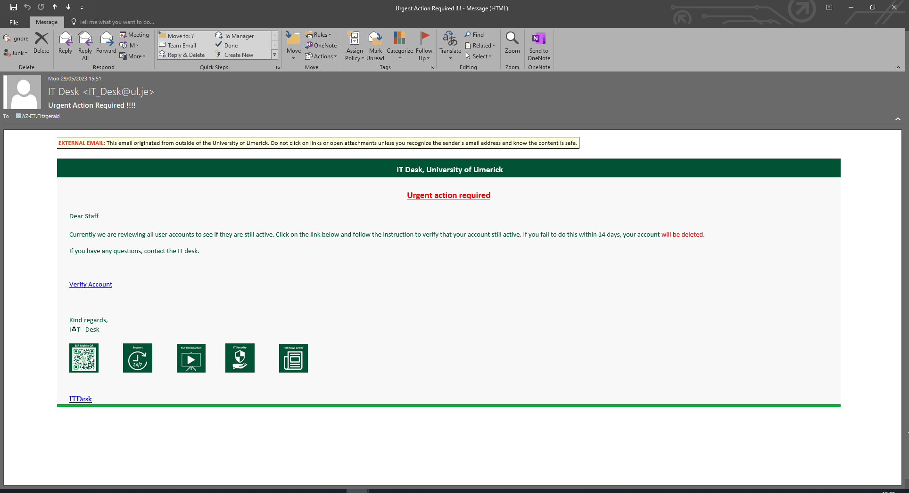
Phishing Email Example
Fake Email address and urgent subject
External Banner
Link to bogus website
Urgent
Spelling / grammar

Slide 8

UL External Email Banner
Emails from outside UL will have this banner displayed at the top of each email to flag it came from an external system

Slide 9
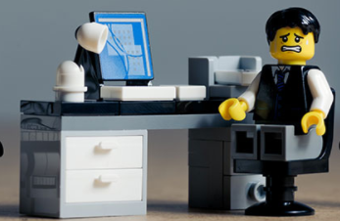
I might have clicked on a phishing email….
What should I do?
It’s quite common for people to only realise an email or website was suspicious afterwards.
You should always report a phishing mail or suspicious website to ITD so that we can help protect your account, data and everyone else in UL.
If you have given away your credentials or clicked on a link – Reporting it means ITD can take steps to protect your account.
If you receive a suspicious email – Reporting it means ITD can remove the email from every mailbox in UL and prevent it going to anyone else.
If you have any IT Security concerns, you can report them via TopDesk for ITD to investigate further

Slide 10
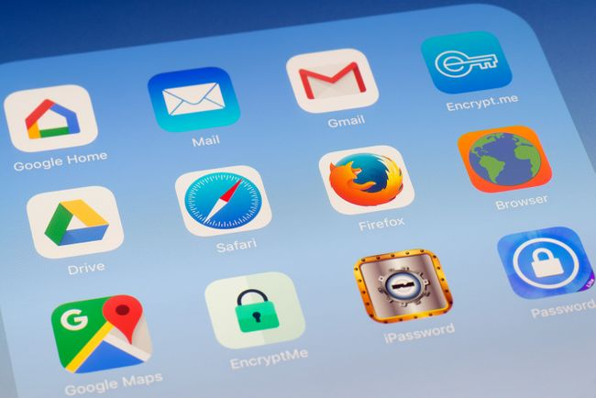
Keeping your UL device secure
Security experts and hackers discover new security flaws in software all the time. Manufacturers update their software to fix all the security weaknesses they know about. You need these updates to remain protected.
Keep computers & devices up-to-date
All manufacturers will eventually stop supporting older Operating Systems. Manufacturers will announce well in advance when they plan to do this, so make sure you upgrade to a supported Operating System.
Devices that are no longer supported will be vulnerable to any security flaws that are discovered from then on, as the manufacturers will not provide any fixes to those devices!
How do I keep my device up-to-date?
Luckily most modern Operating Systems (Windows 10/Apple Mac) will tell you when there are new updates waiting to be installed and these can be scheduled for when you’re not using the device.

Slide 11
Keeping your UL device secure
Operating System Patching – Windows devices are centrally managed by ITD and patched on a monthly basis
Anti-Virus
All UL devices must use the approved AV solution. Within UL this is Defender for Endpoint and is automatically configured on Windows devices by ITD.
Encryption
All UL laptops/mobile devices must be encrypted. Windows laptops provided by are automatically encrypted as part of the deployment.
Modern mobile devices (phones/tablets) are encrypted by default.

Slide 12
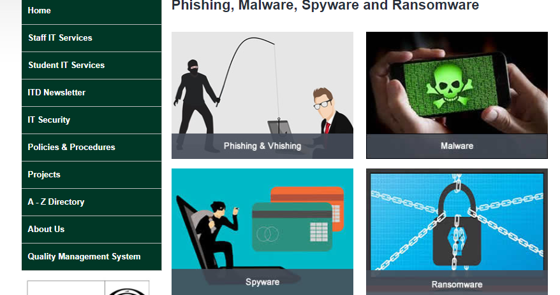
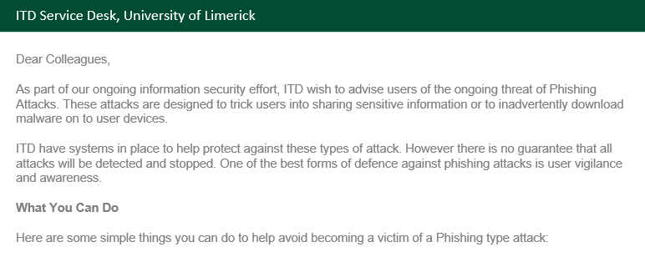
Stay Informed
  ITD provide information to staff & students on an ongoing basis to help keep you informed of the latest threats and how to protect yourself.
  UL Website – ITD Security Section
  UL Connect – Security Notifications (Active Phishing Threats/Potential Credential Theft)

